Slide 1
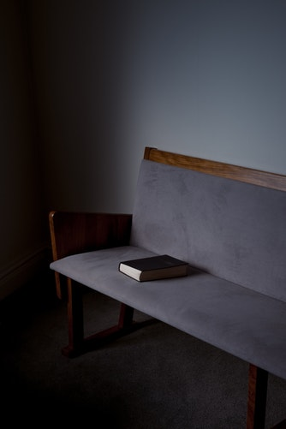
Please be seated
59
58
57
56
55
54
53
52
51
50
49
48
47
46
45
44
43
42
41
40
39
38
37
36
35
34
33
32
31
30
29
28
27
26
25
24
23
22
21
20
19
18
17
16
15
14
13
12
11
10
09
08
07
06
05
04
03
02
01
00
00

Slide 2


WELCOME
to

Slide 3

Call to Worship

Slide 4
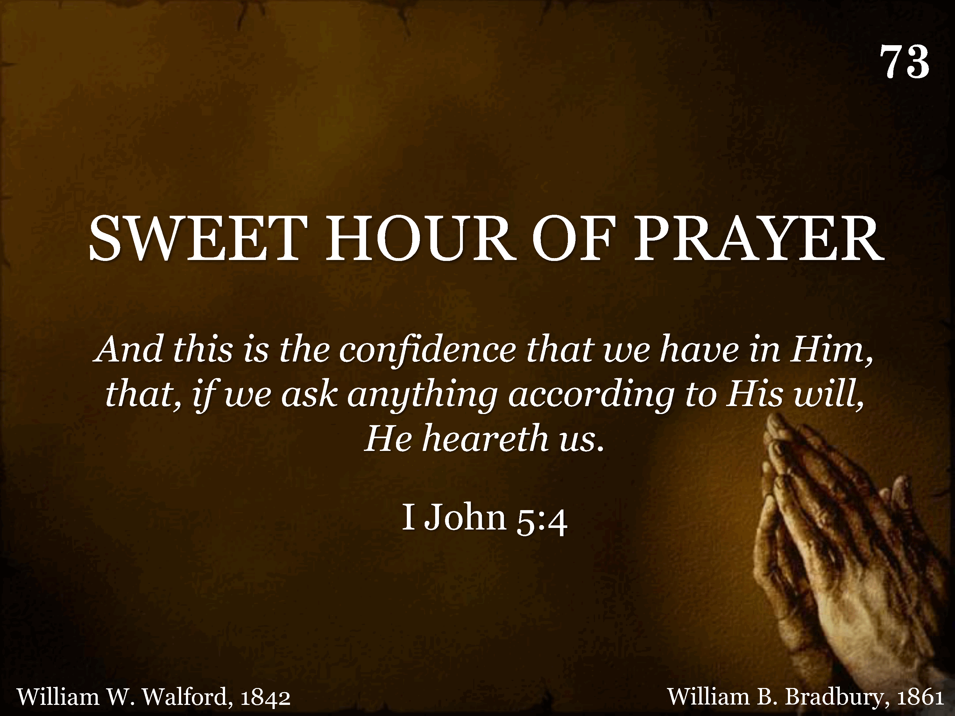
073 - Sweet Hour Of Prayer - Title
CCLI #21593236

Slide 5
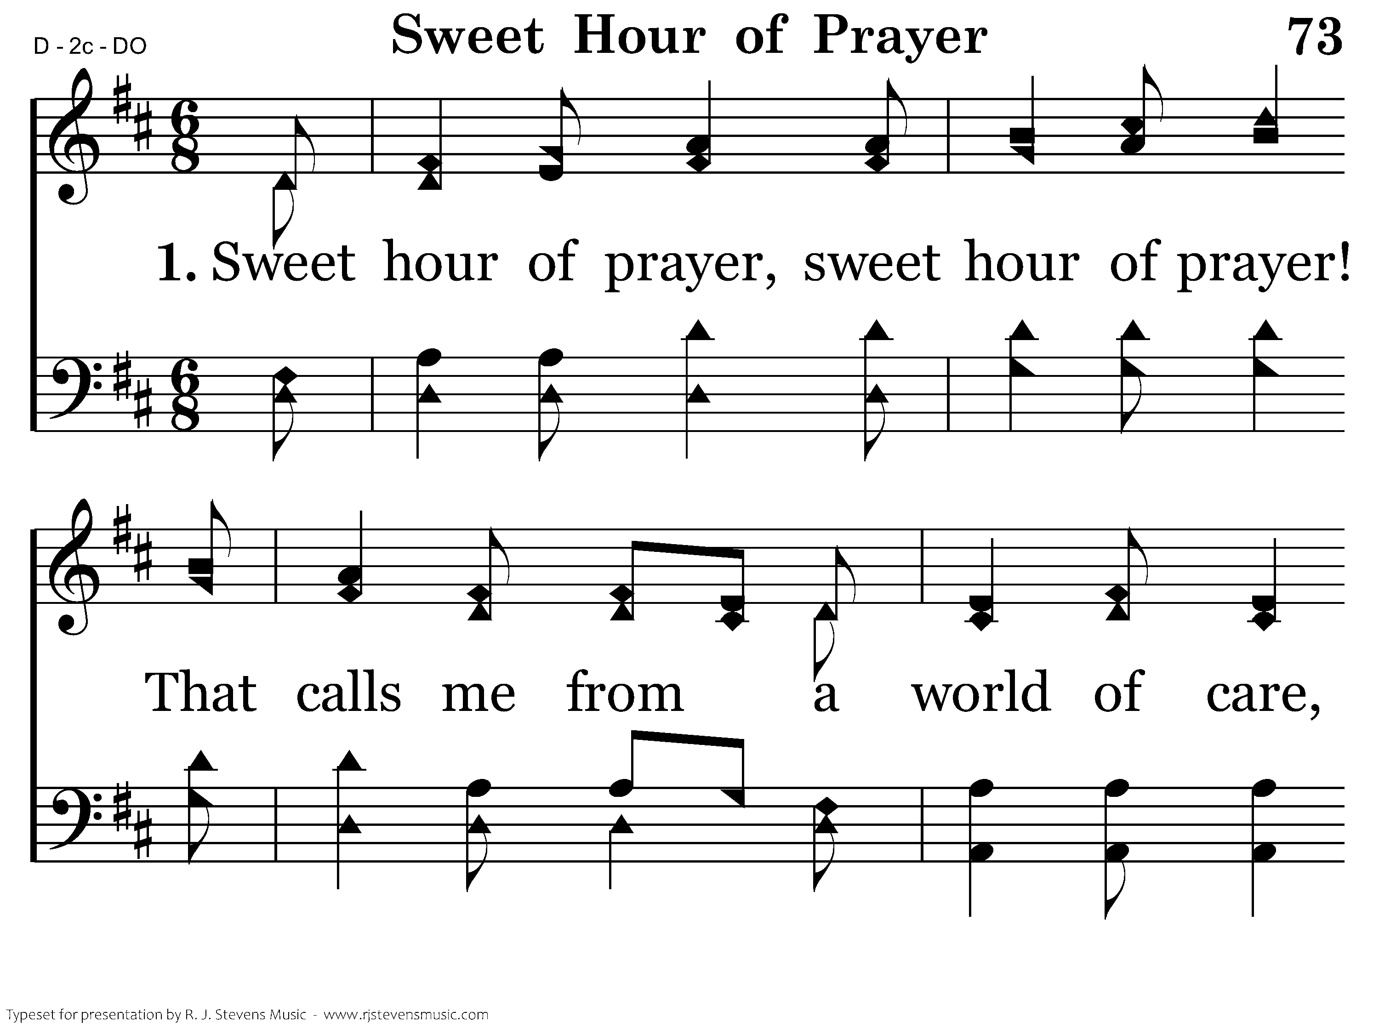
073 - Sweet Hour Of Prayer - 1.1
CCLI #21593236

Slide 6
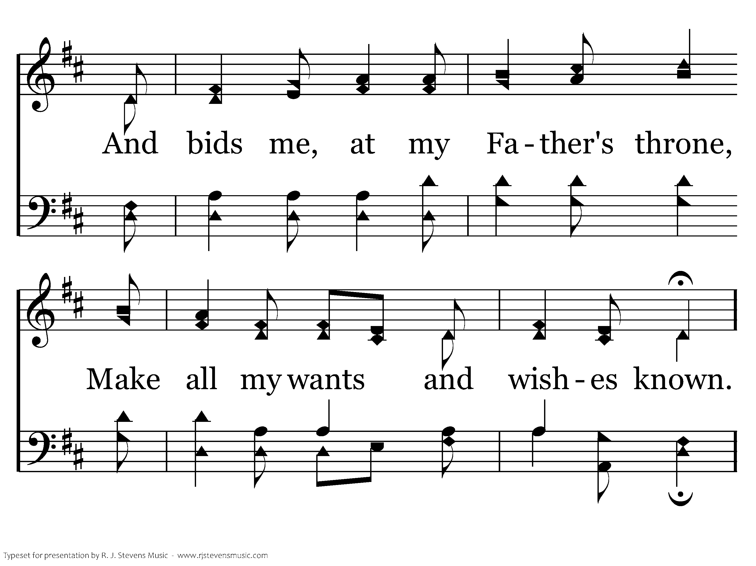
073 - Sweet Hour Of Prayer - 1.2
CCLI #21593236

Slide 7
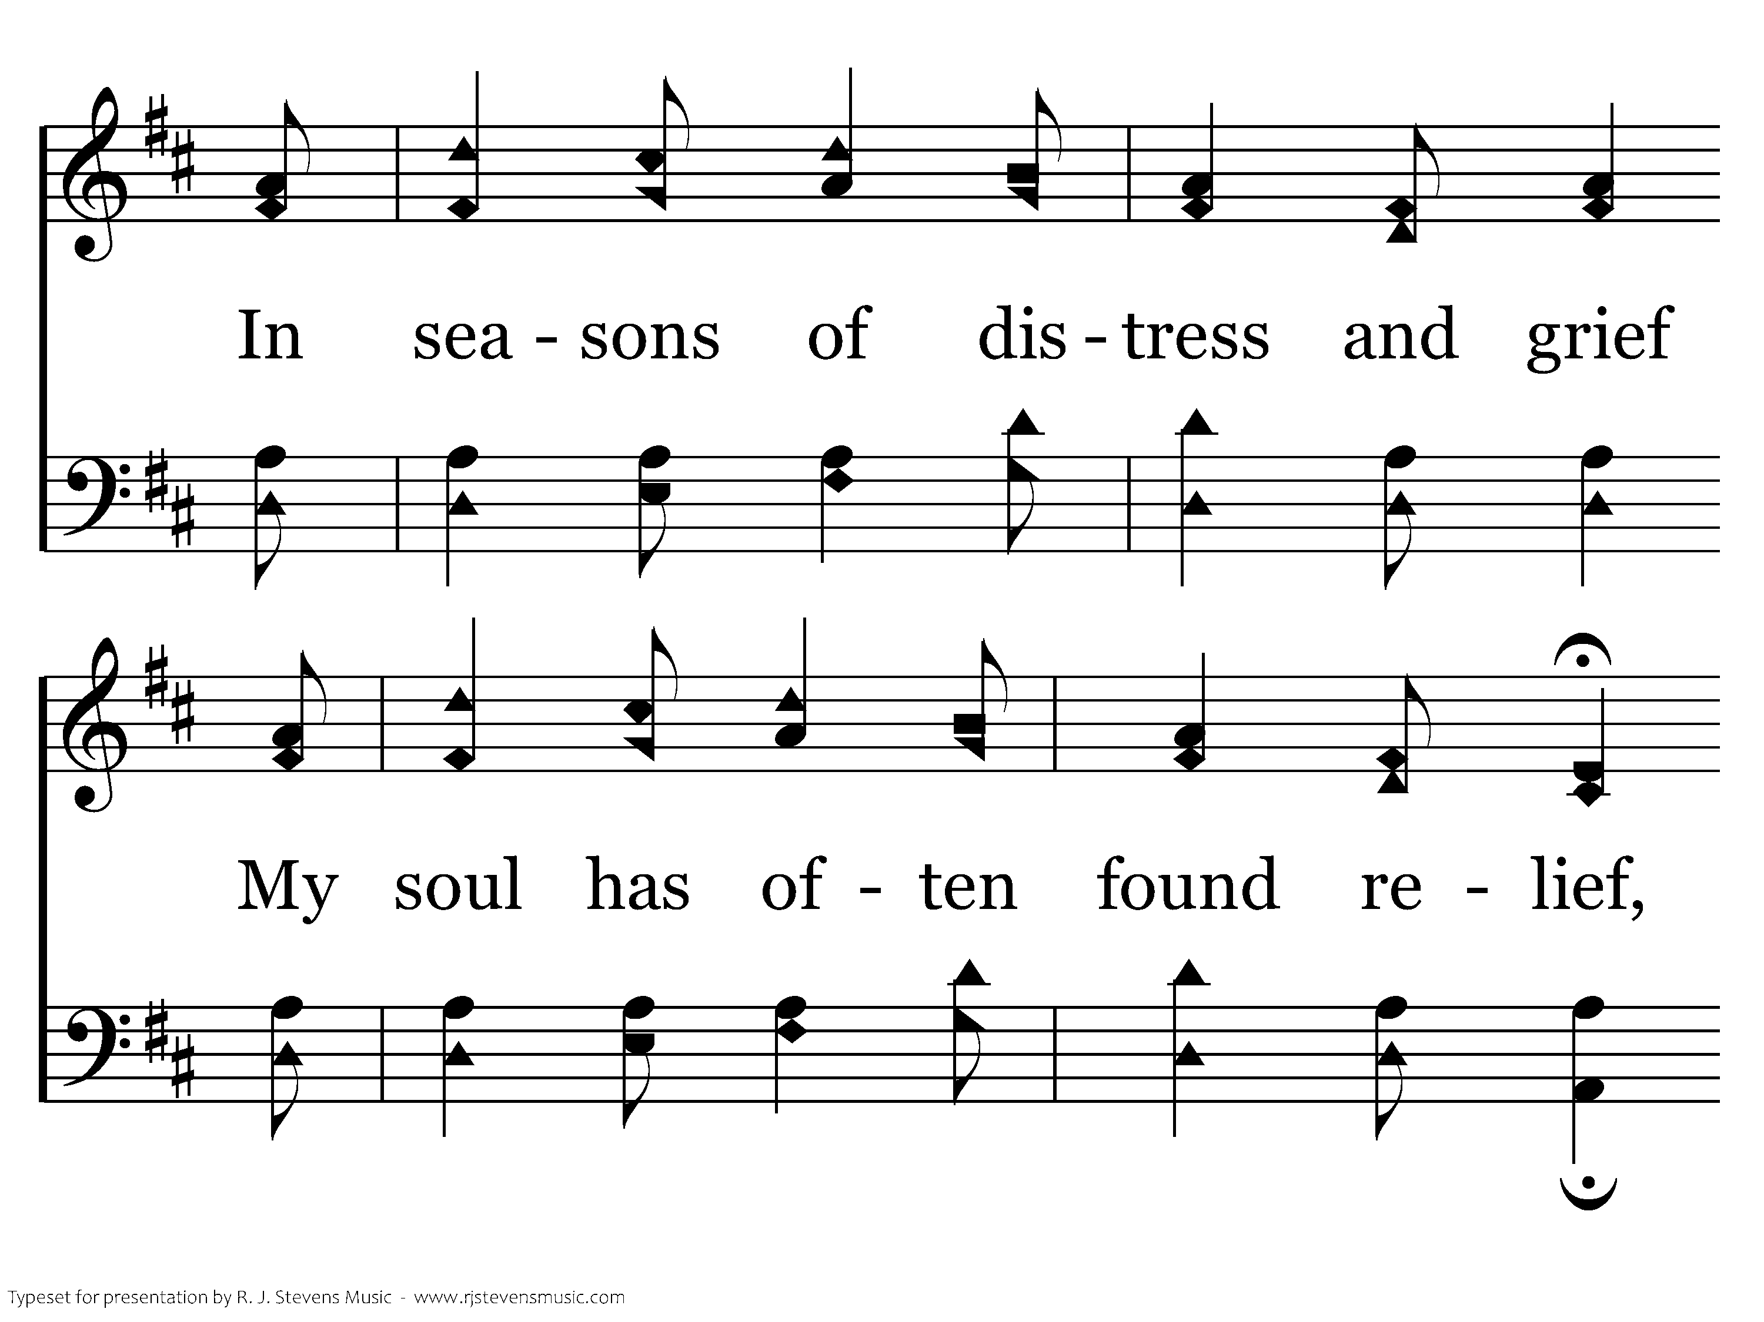
073 - Sweet Hour Of Prayer - 1.3
CCLI #21593236

Slide 8
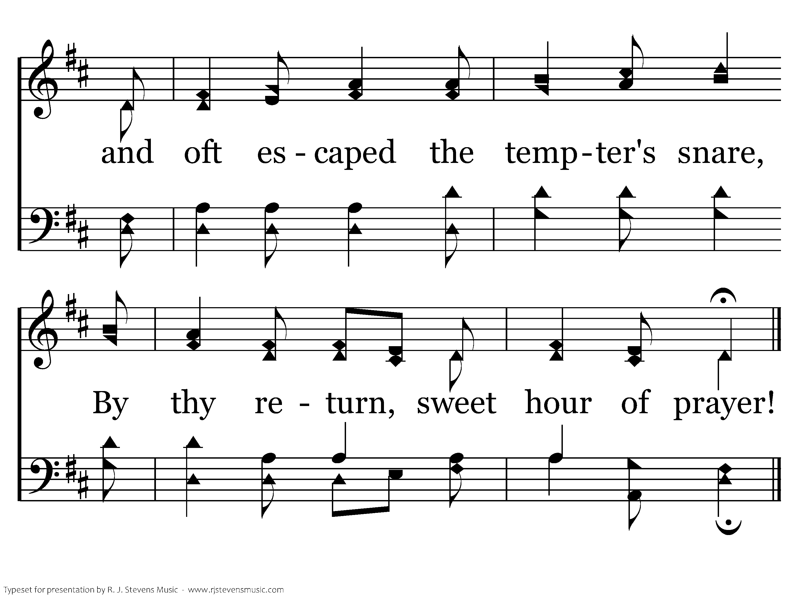
073 - Sweet Hour Of Prayer - 1.4
CCLI #21593236
End of Verse 1

Slide 9
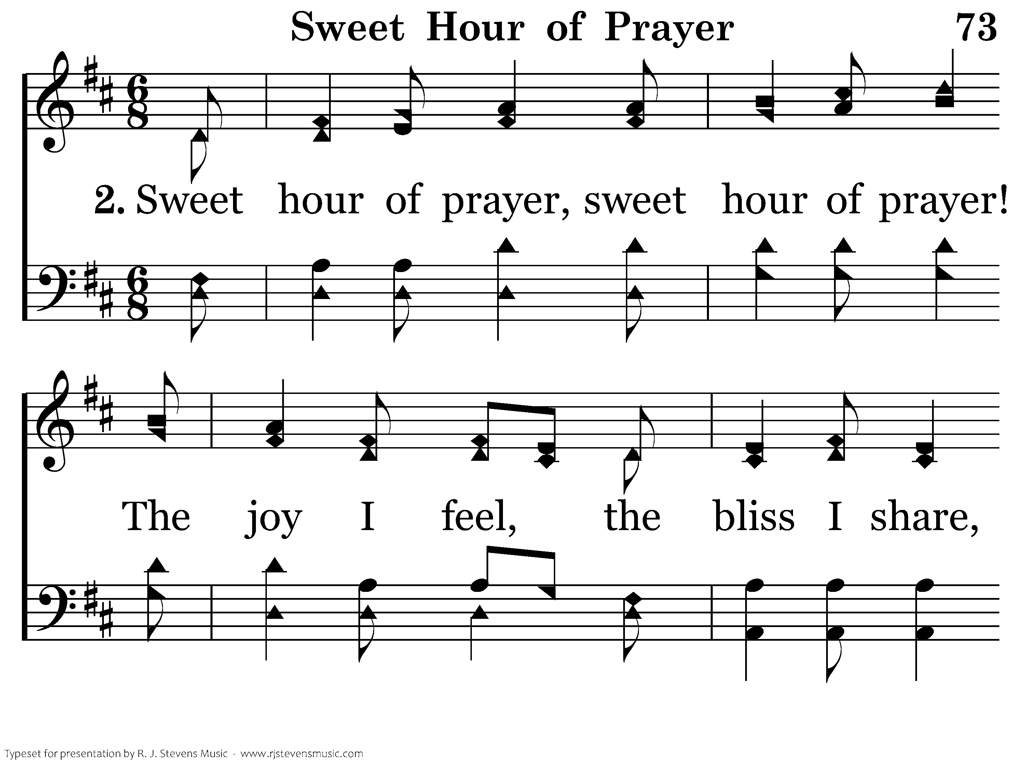
073 - Sweet Hour Of Prayer - 2.1
CCLI #21593236

Slide 10
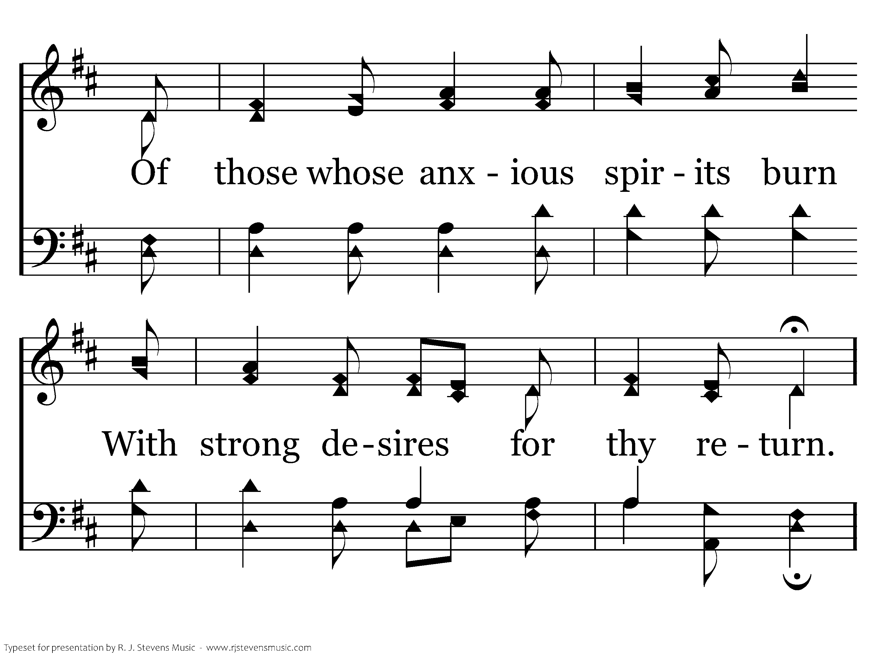
073 - Sweet Hour Of Prayer - 2.2
CCLI #21593236

Slide 11
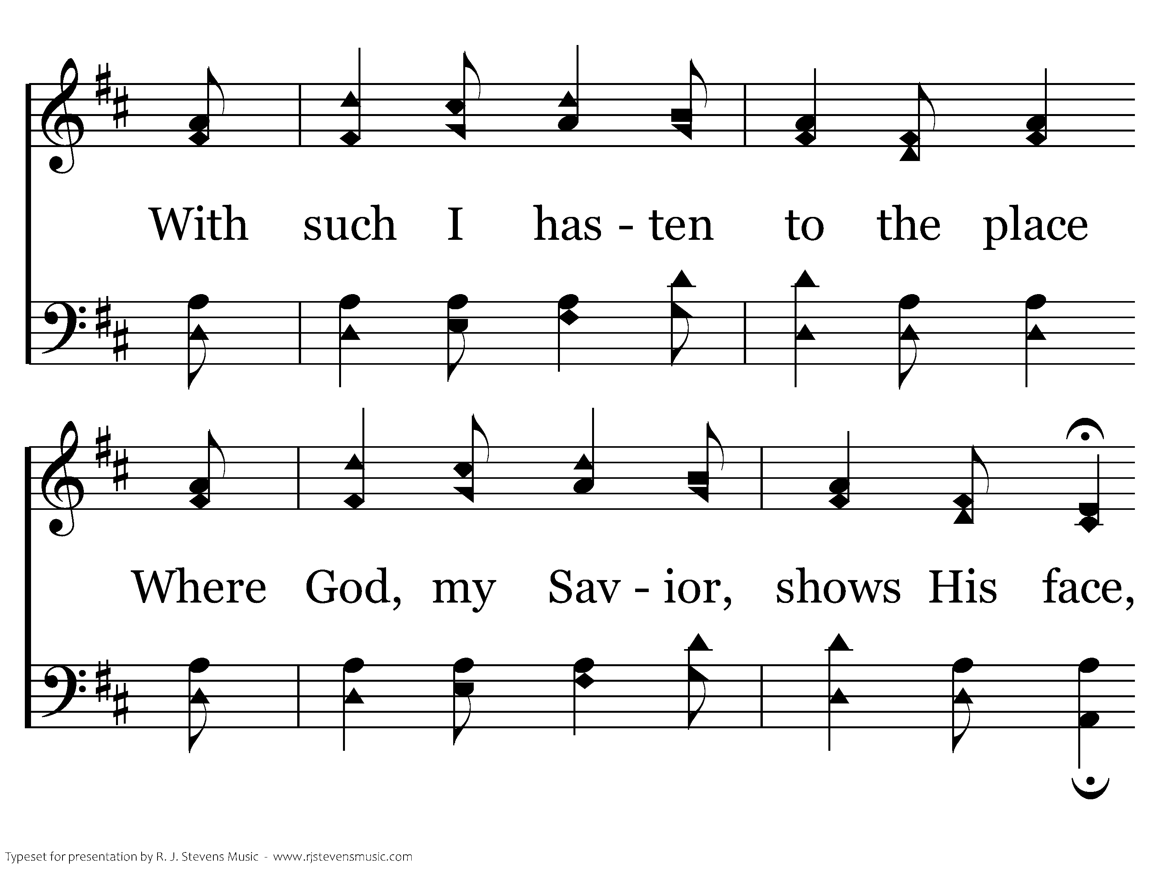
073 - Sweet Hour Of Prayer - 2.3
CCLI #21593236

Slide 12
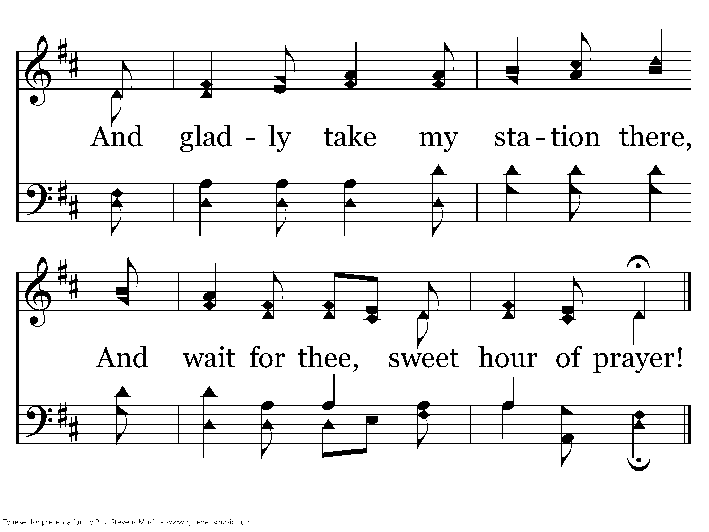
073 - Sweet Hour Of Prayer - 2.4
CCLI #21593236
End of Verse 2

Slide 13
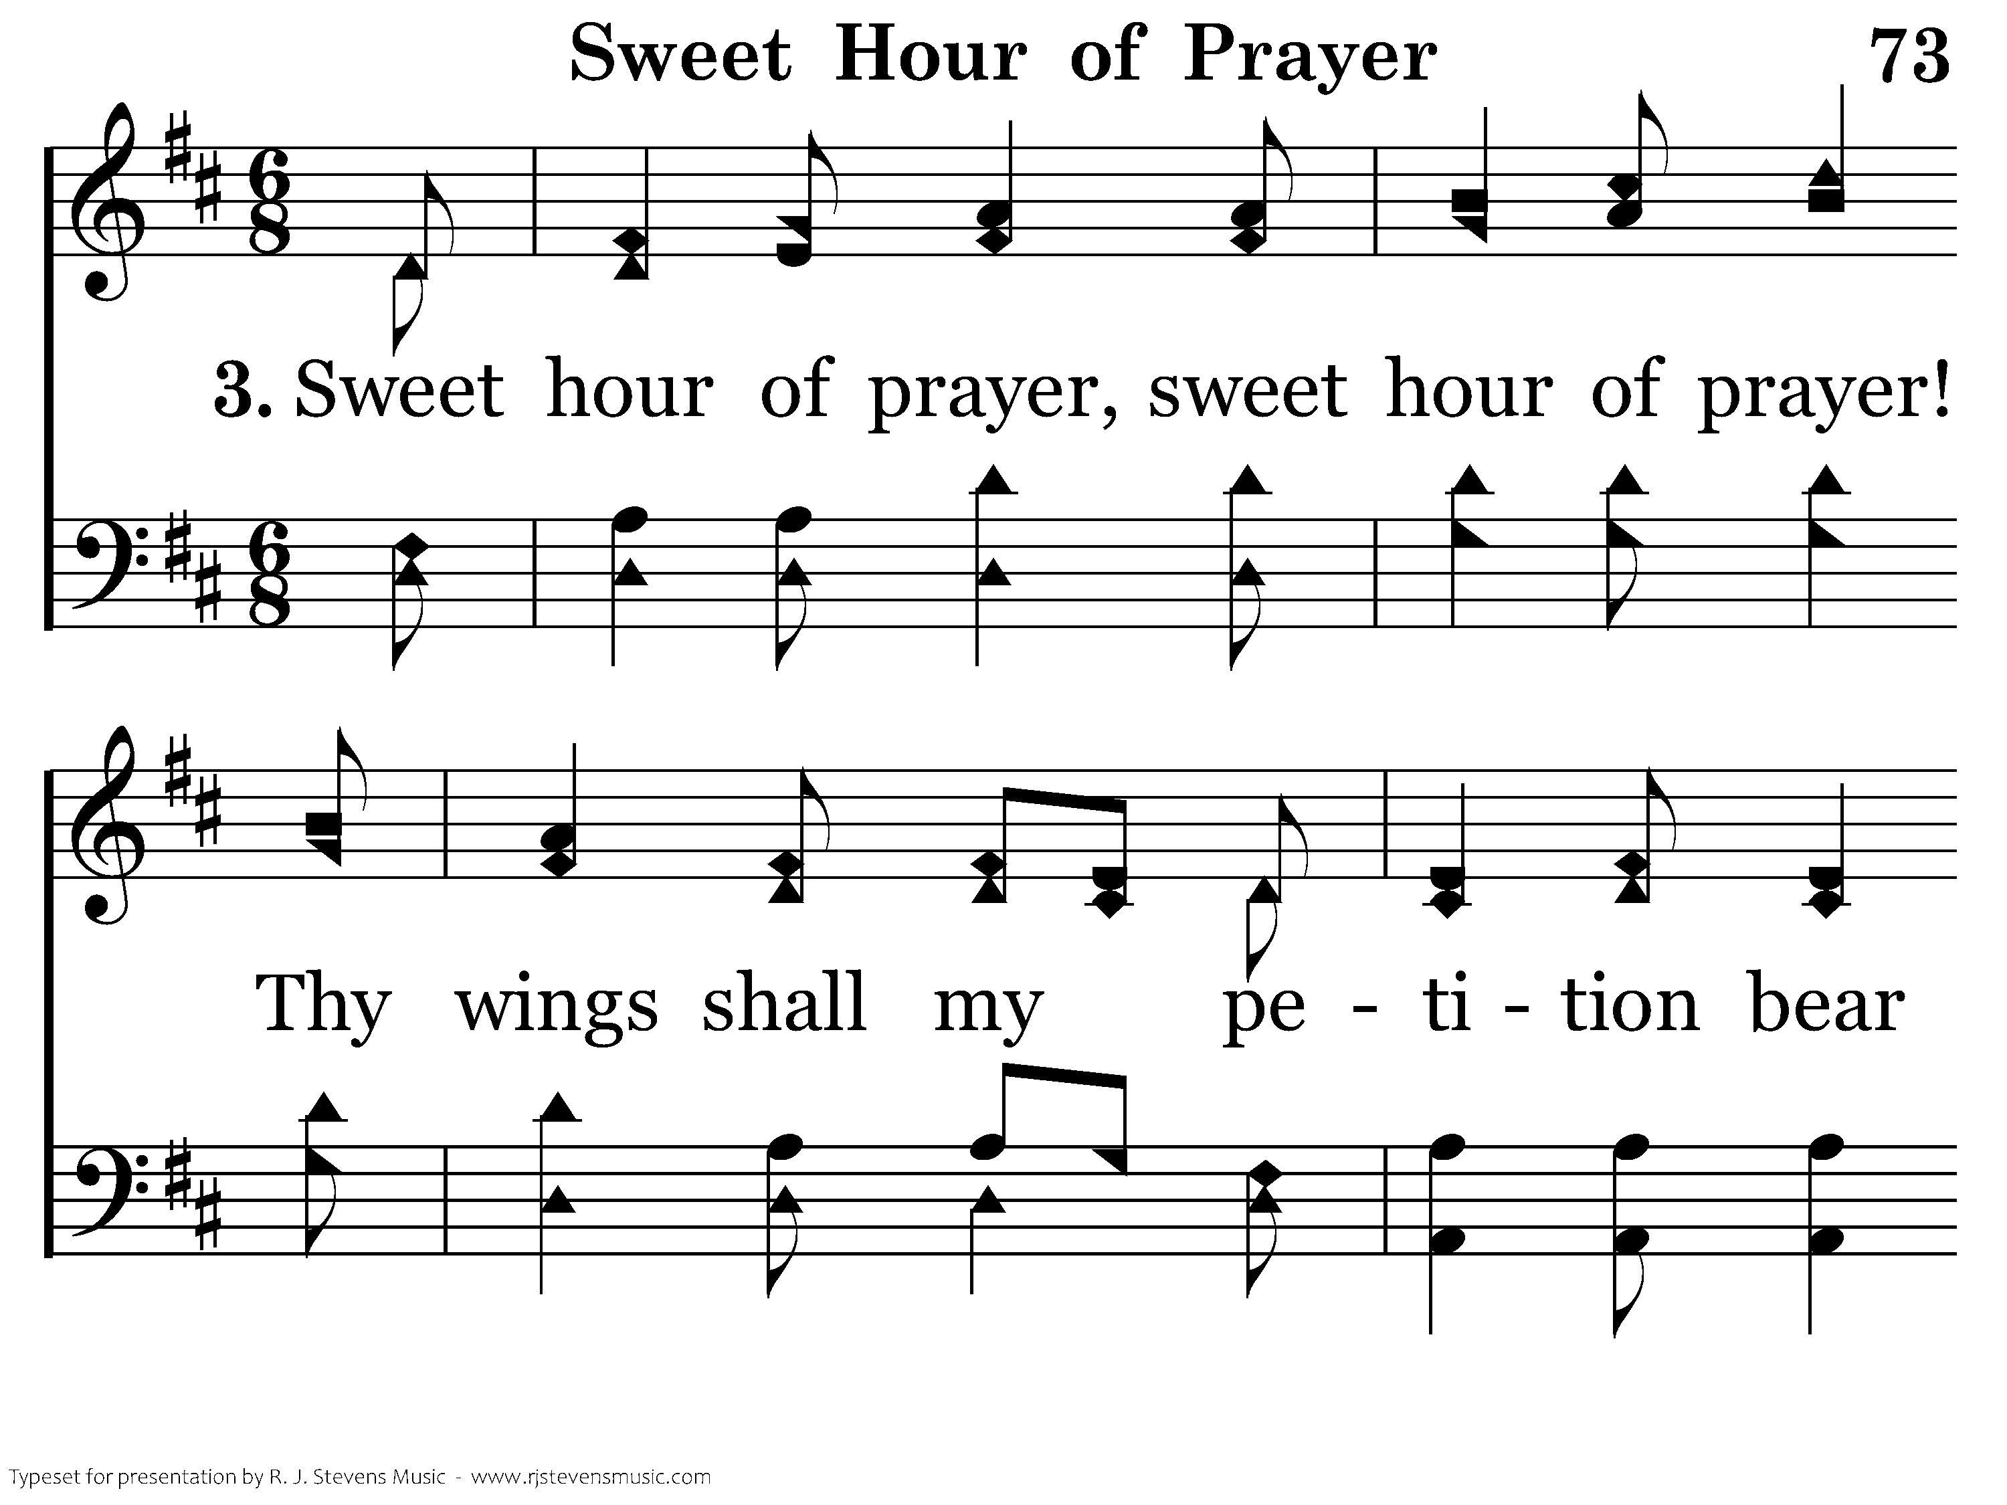
073 - Sweet Hour Of Prayer - 3.1
CCLI #21593236

Slide 14
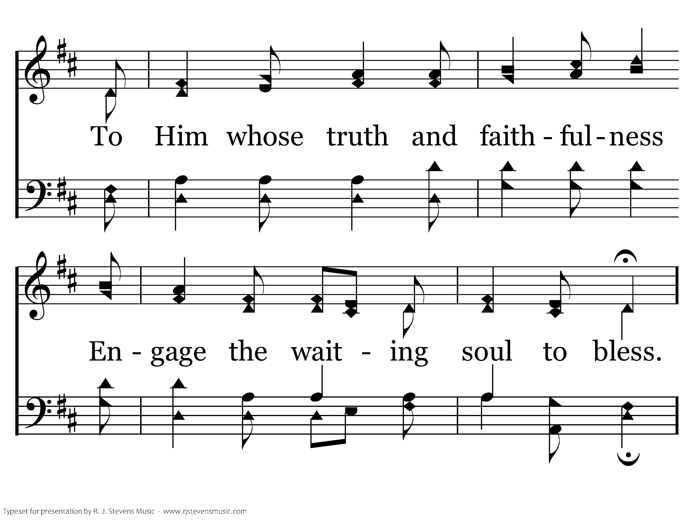
073 - Sweet Hour Of Prayer - 3.2
CCLI #21593236

Slide 15
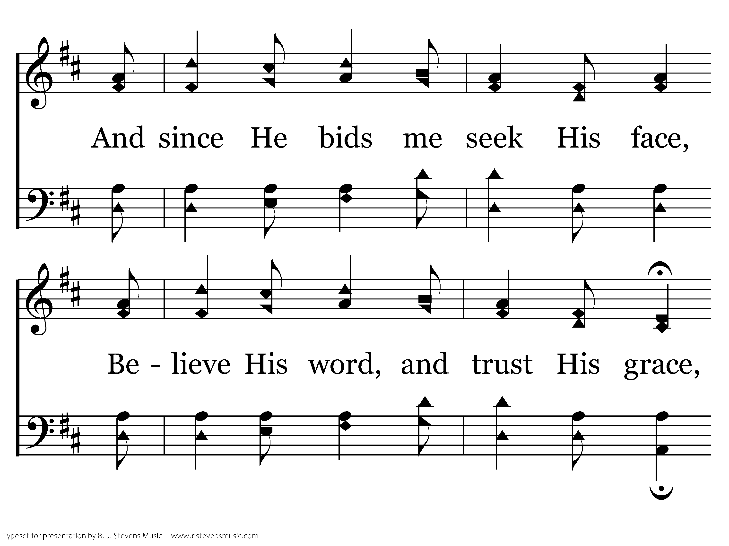
073 - Sweet Hour Of Prayer - 3.3
CCLI #21593236

Slide 16
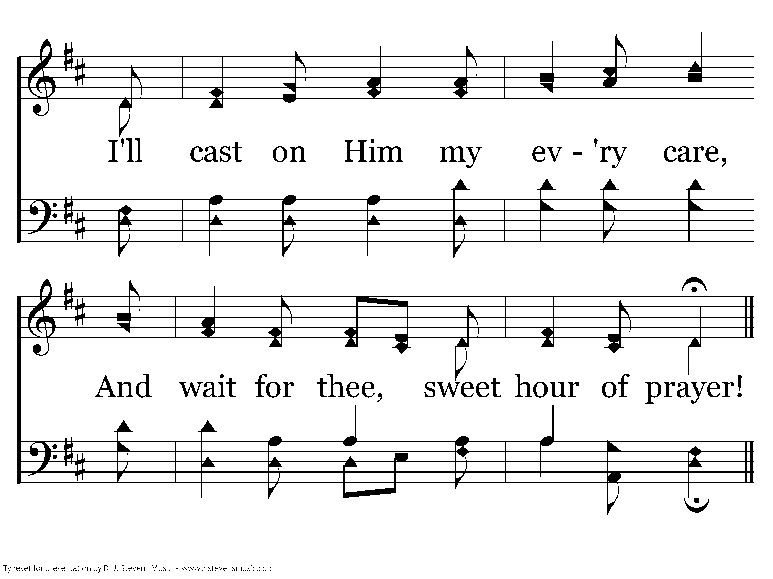
073 - Sweet Hour Of Prayer - 3.4
CCLI #21593236
End of Song

Slide 17
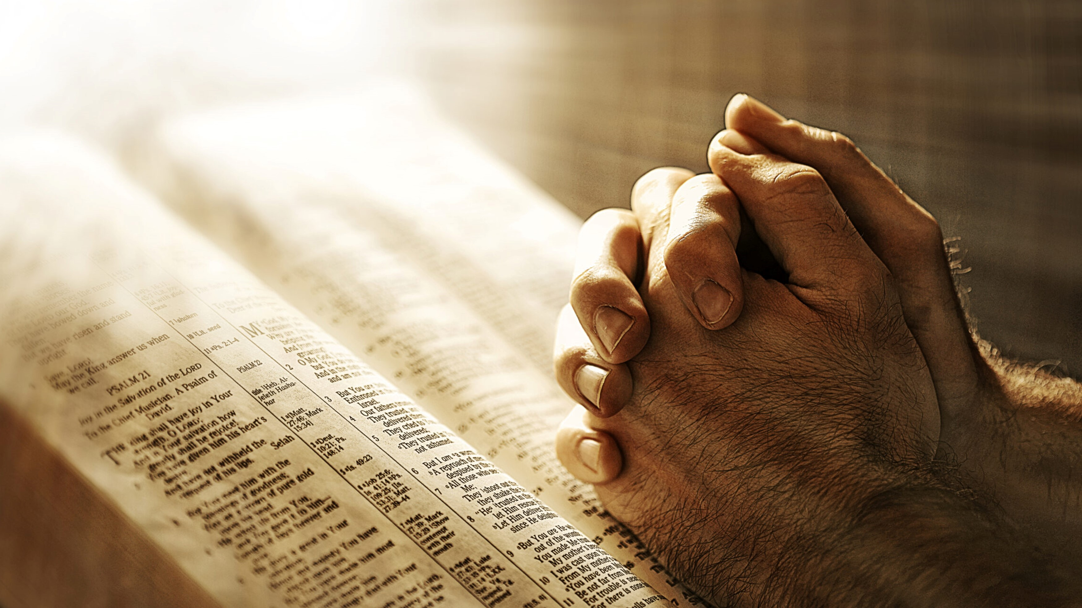
Prayer

Slide 18
Only on the Slides
Oh, The Blood
“For as by a man came death, by a man has come also the resurrection of the dead. For as in Adam all die, so also in Christ shall all be made alive.”
1 Corinthians 15: 21-22
Arr: Mike Rogers
Words and Music by: Mike Rogers
CCLI #21593236
© 2014 The Acappella Company

Slide 19
V1a – Oh the Blood
Arr: Mike Rogers
Words and Music by: Mike Rogers
© 2014 The Acappella Company

Slide 20
V1b – Oh the Blood

Slide 21
C1a – Oh the Blood

Slide 22
C1b – Oh the Blood

Slide 23
V2a – Oh the Blood
© 2014 The Acappella Company

Slide 24
V2b – Oh the Blood

Slide 25
C2a – Oh the Blood

Slide 26
C2b – Oh the Blood

Slide 27
V3a – Oh the Blood

Slide 28
V3b – Oh the Blood

Slide 29
C3a – Oh the Blood

Slide 30
C3b – Oh the Blood

Slide 31
C3c – Oh the Blood
End of Song

Slide 32


Slide 33
1 Corinthians 11: 23-28

Slide 34
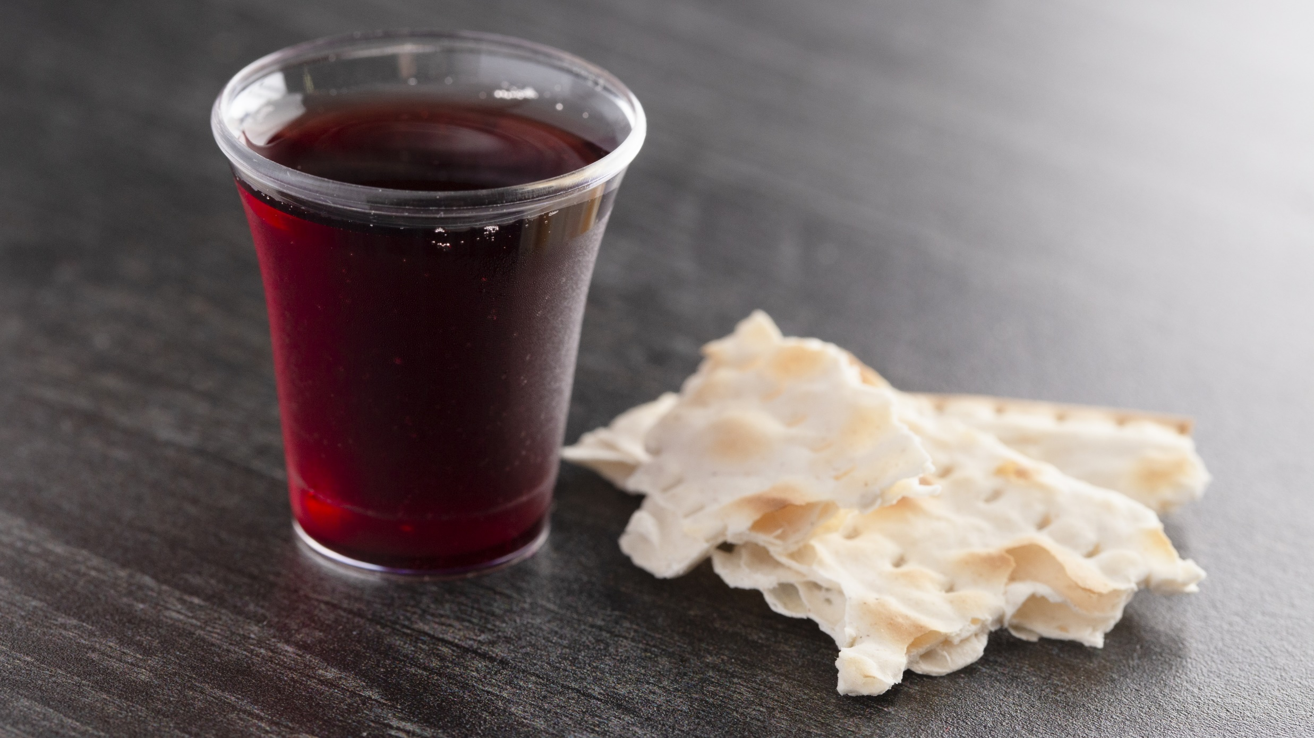
“Do this in remembrance of me.”
(Luke 22:19)

Slide 35
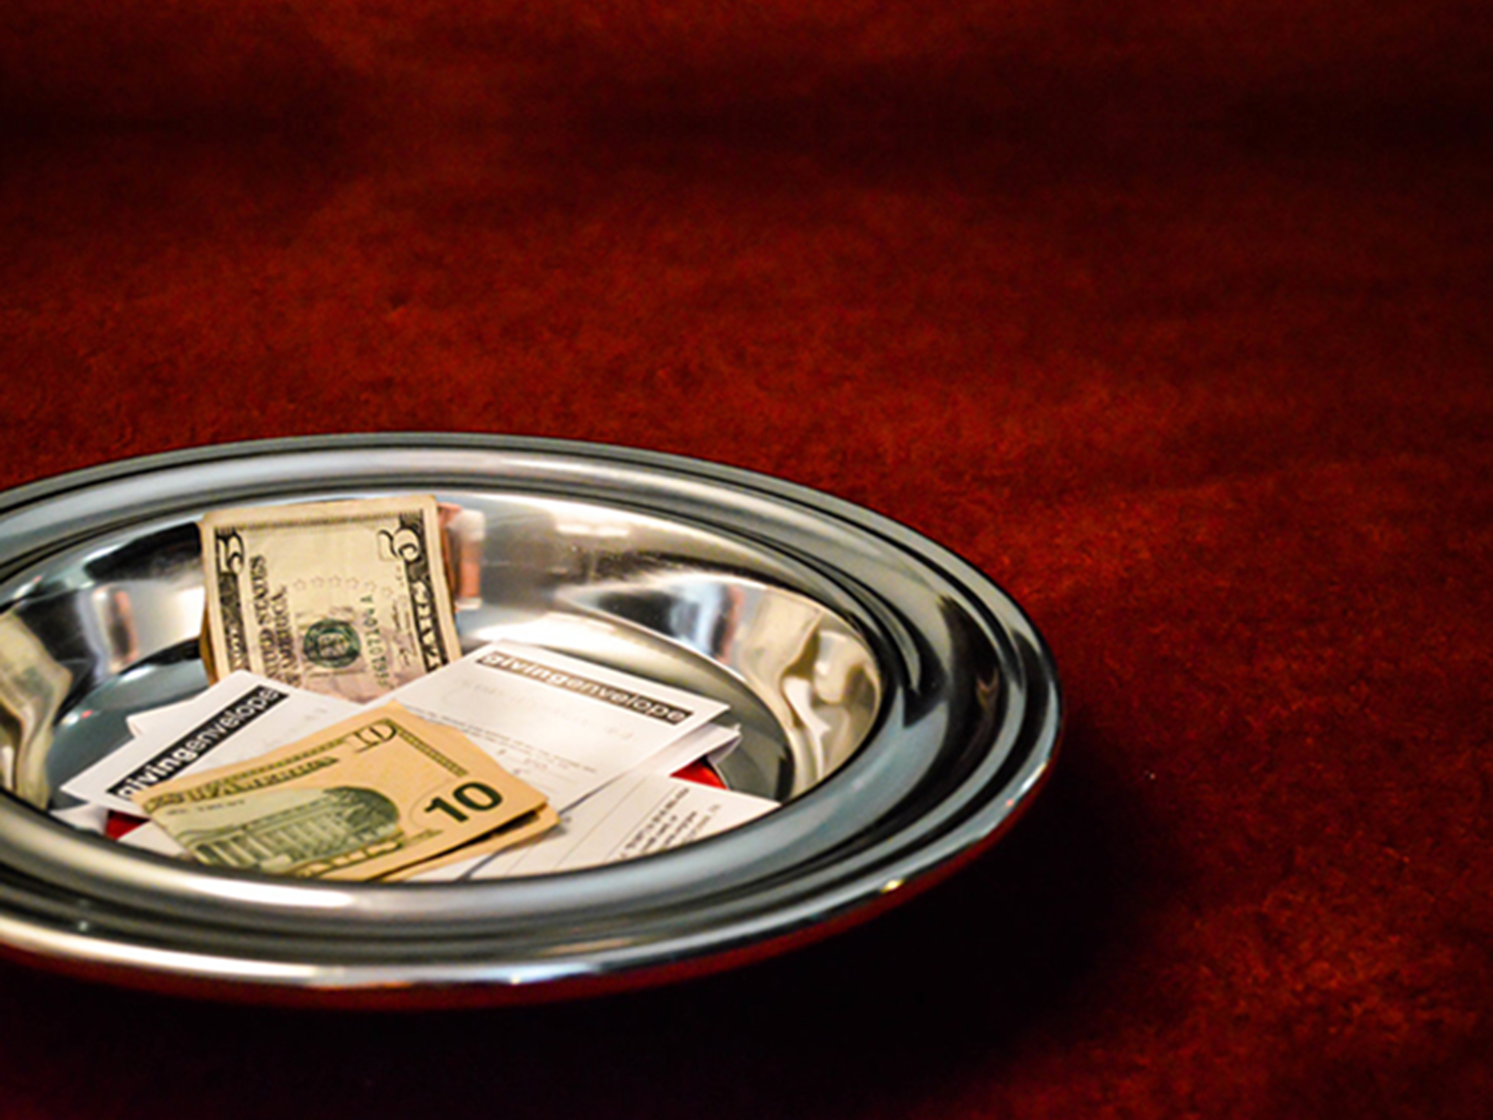




Giving
Back to the Lord
⁷ Each one must give as he has decided in his heart, not reluctantly or under compulsion, for God loves a cheerful giver.
(2 Corinthians 9:7)
or we have the basket in the back of the auditorium

Slide 36
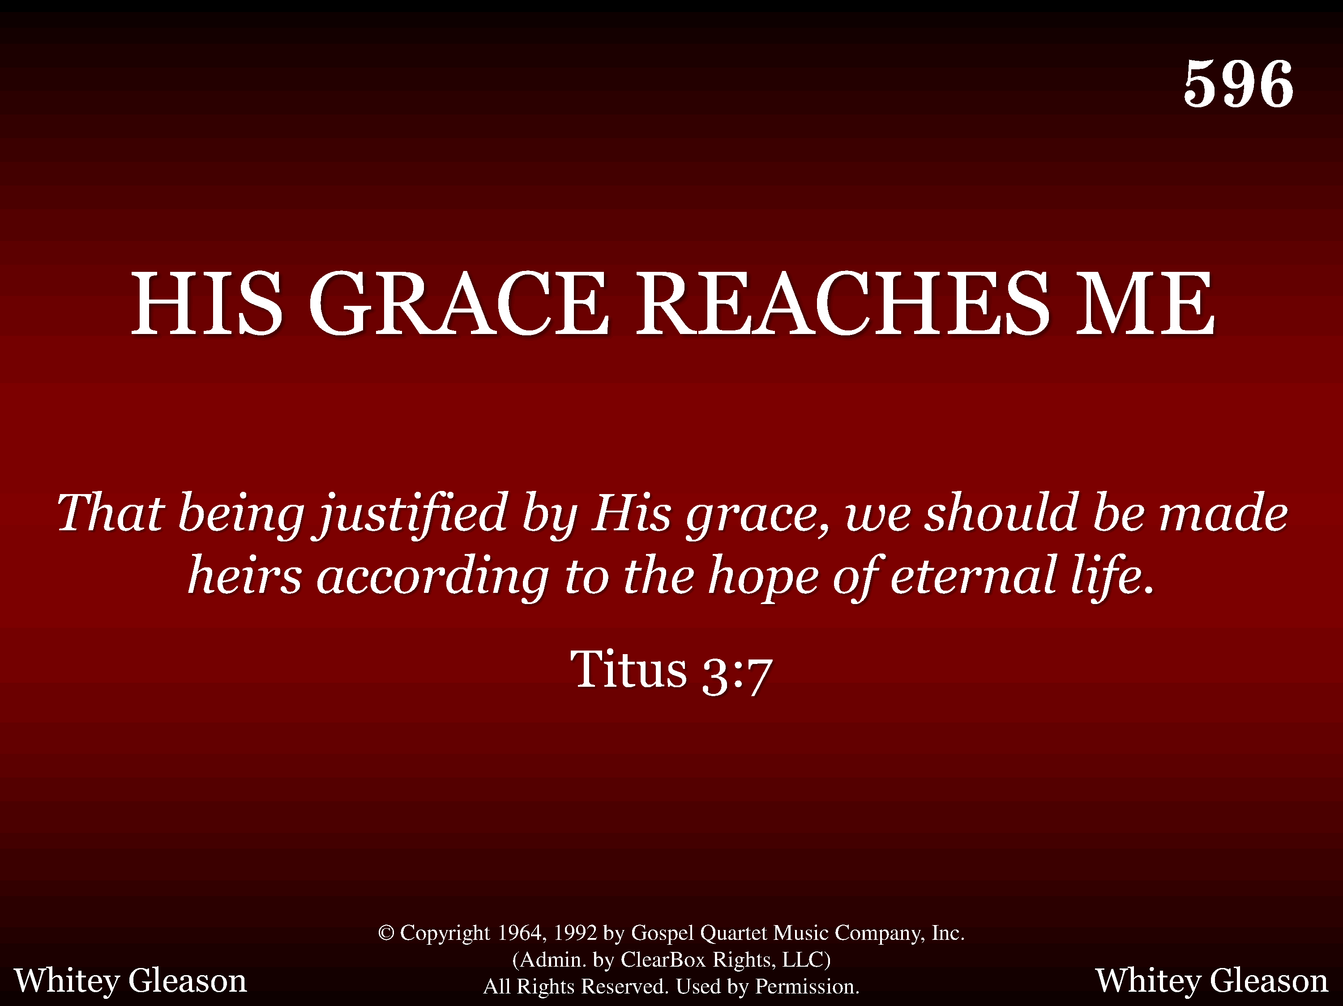
596 - His Grace Reaches Me - Title
CCLI #21593236

Slide 37
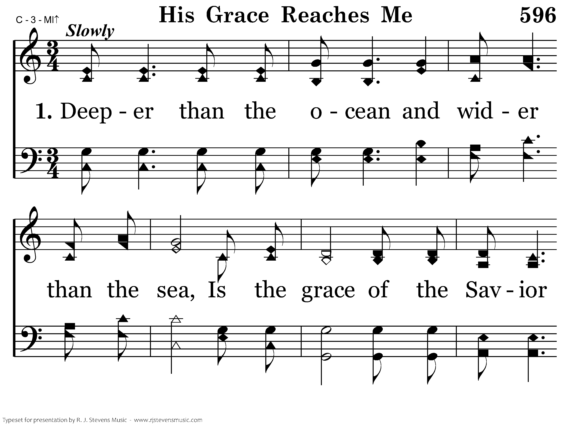
596 - His Grace Reaches Me - 1.1
CCLI #21593236

Slide 38
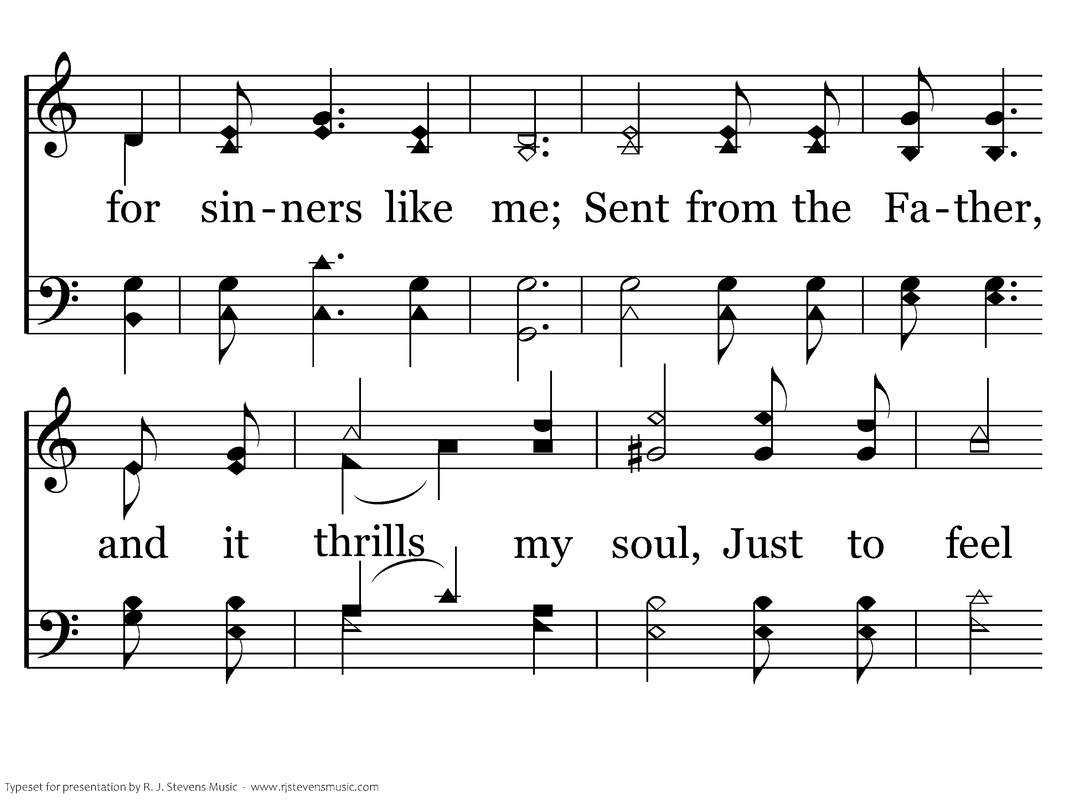
596 - His Grace Reaches Me - 1.2
CCLI #21593236

Slide 39
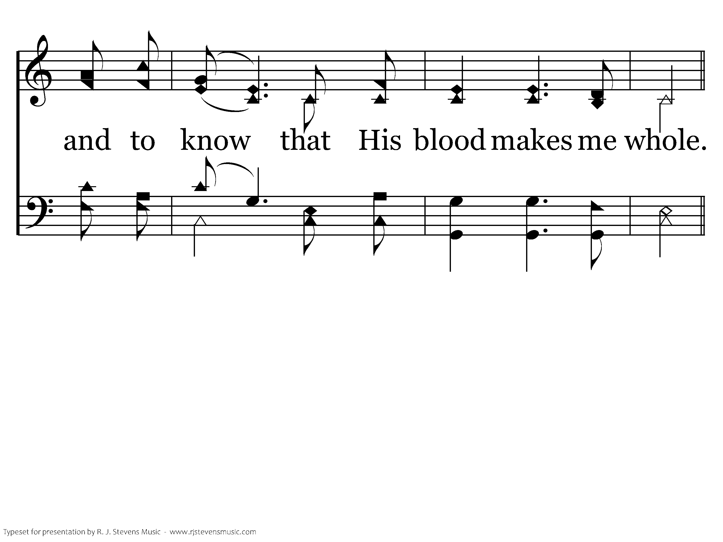
596 - His Grace Reaches Me - 1.3
CCLI #21593236

Slide 40
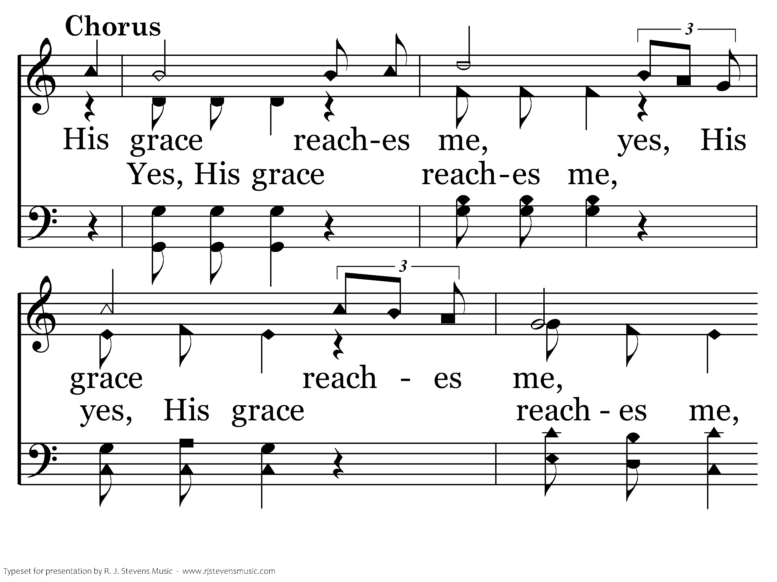
596 - His Grace Reaches Me - C.1
CCLI #21593236

Slide 41
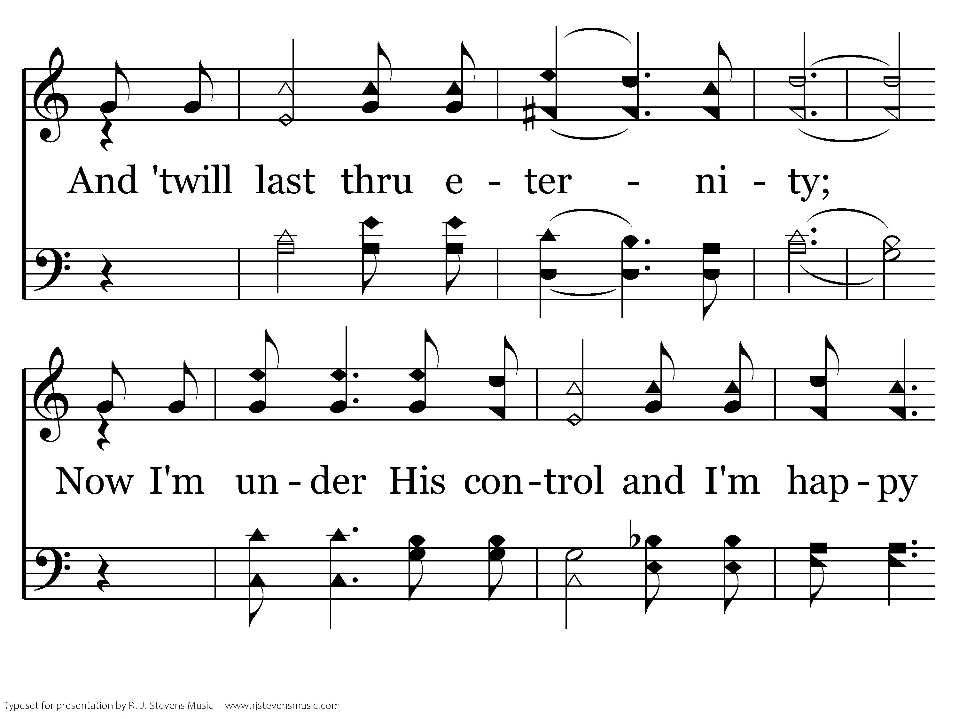
596 - His Grace Reaches Me - C.2
CCLI #21593236

Slide 42
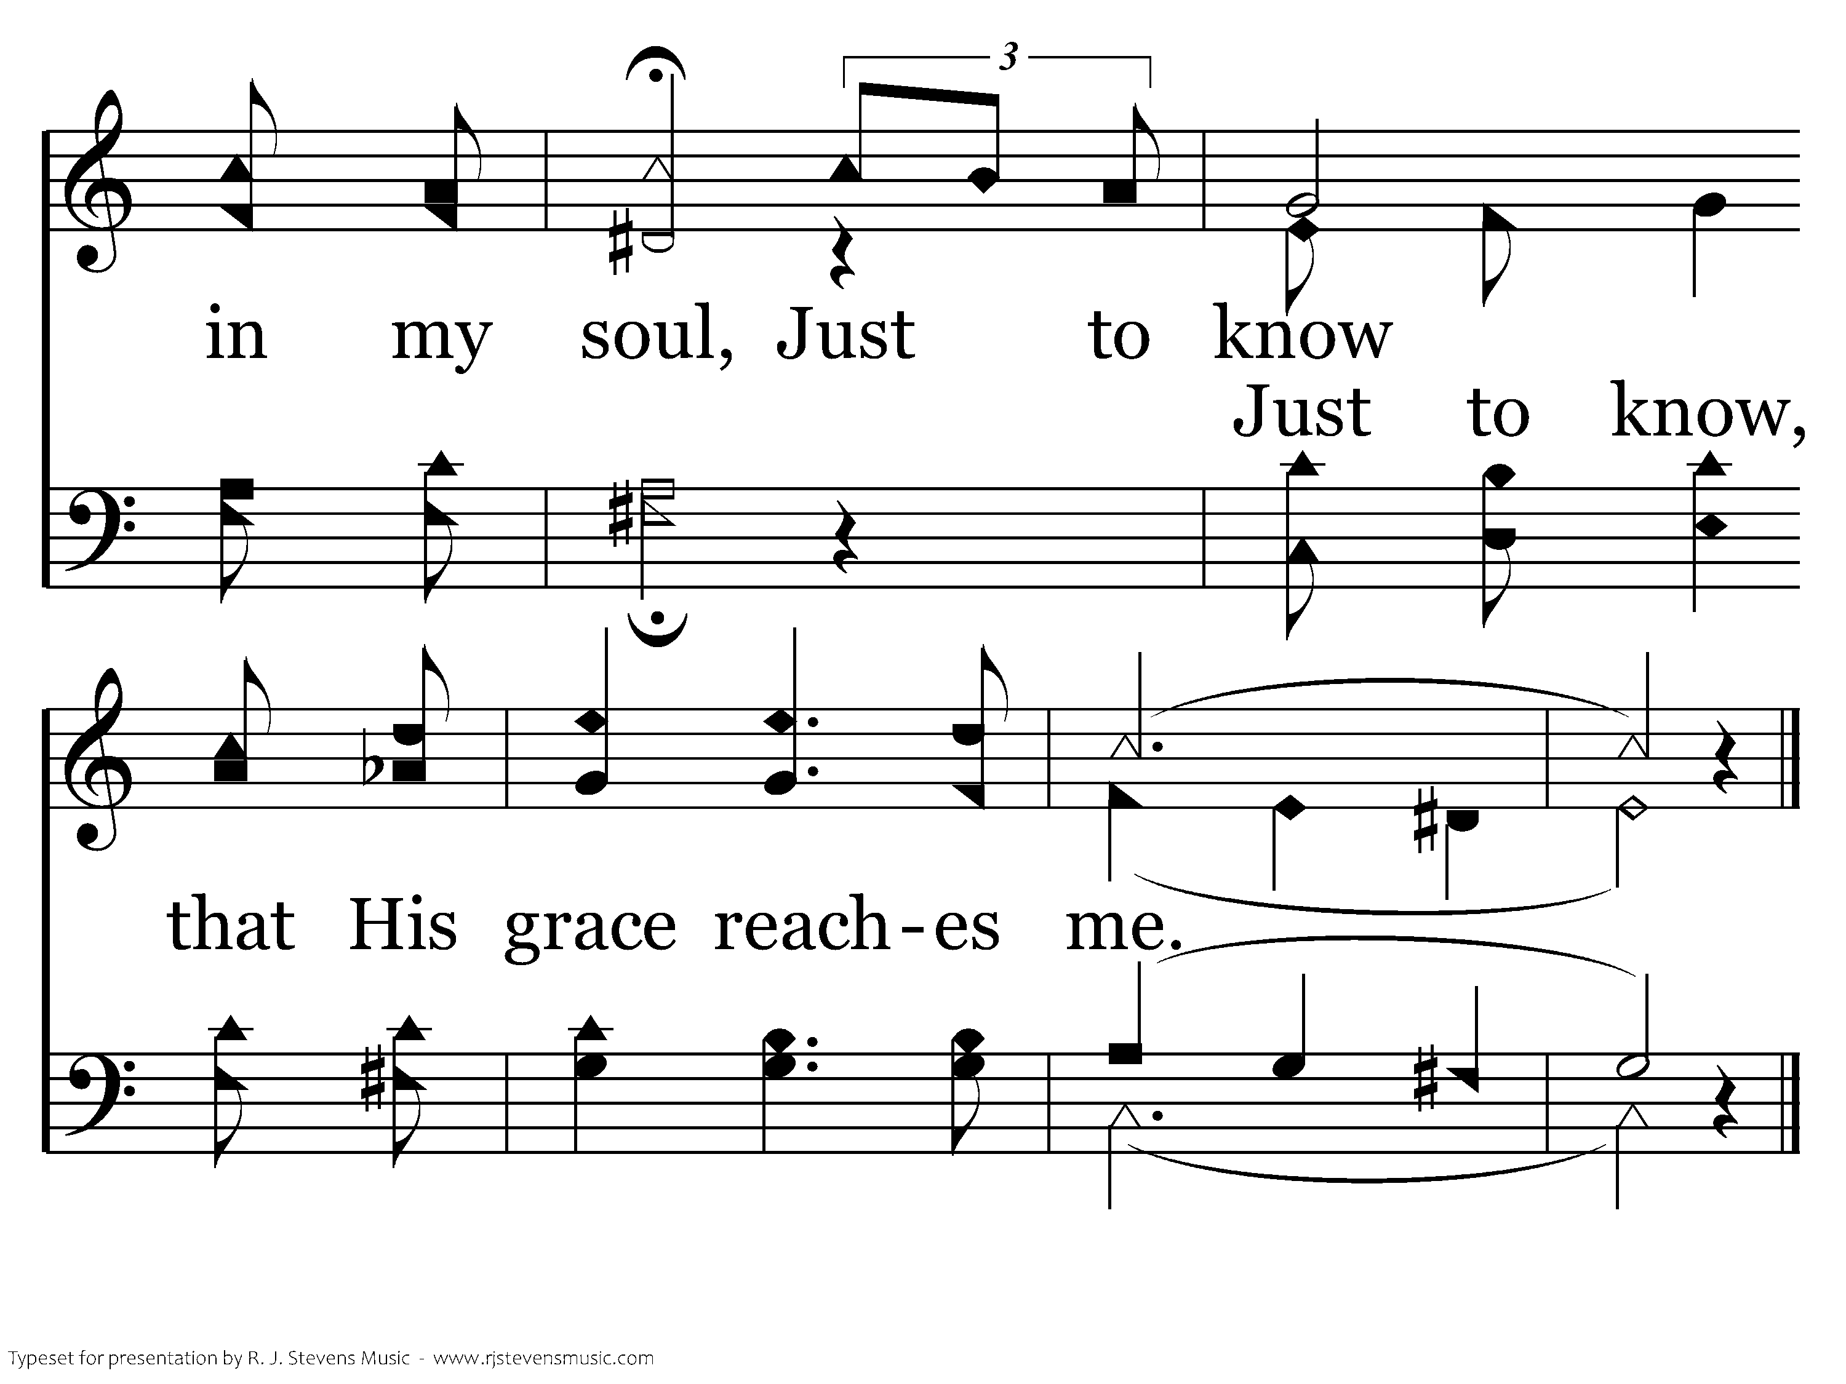
596 - His Grace Reaches Me - C.3
CCLI #21593236
End of Verse 1

Slide 43
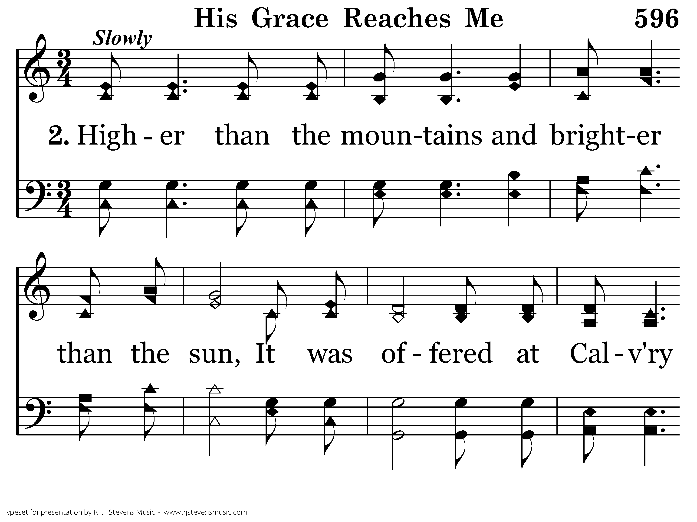
596 - His Grace Reaches Me - 2.1
CCLI #21593236

Slide 44
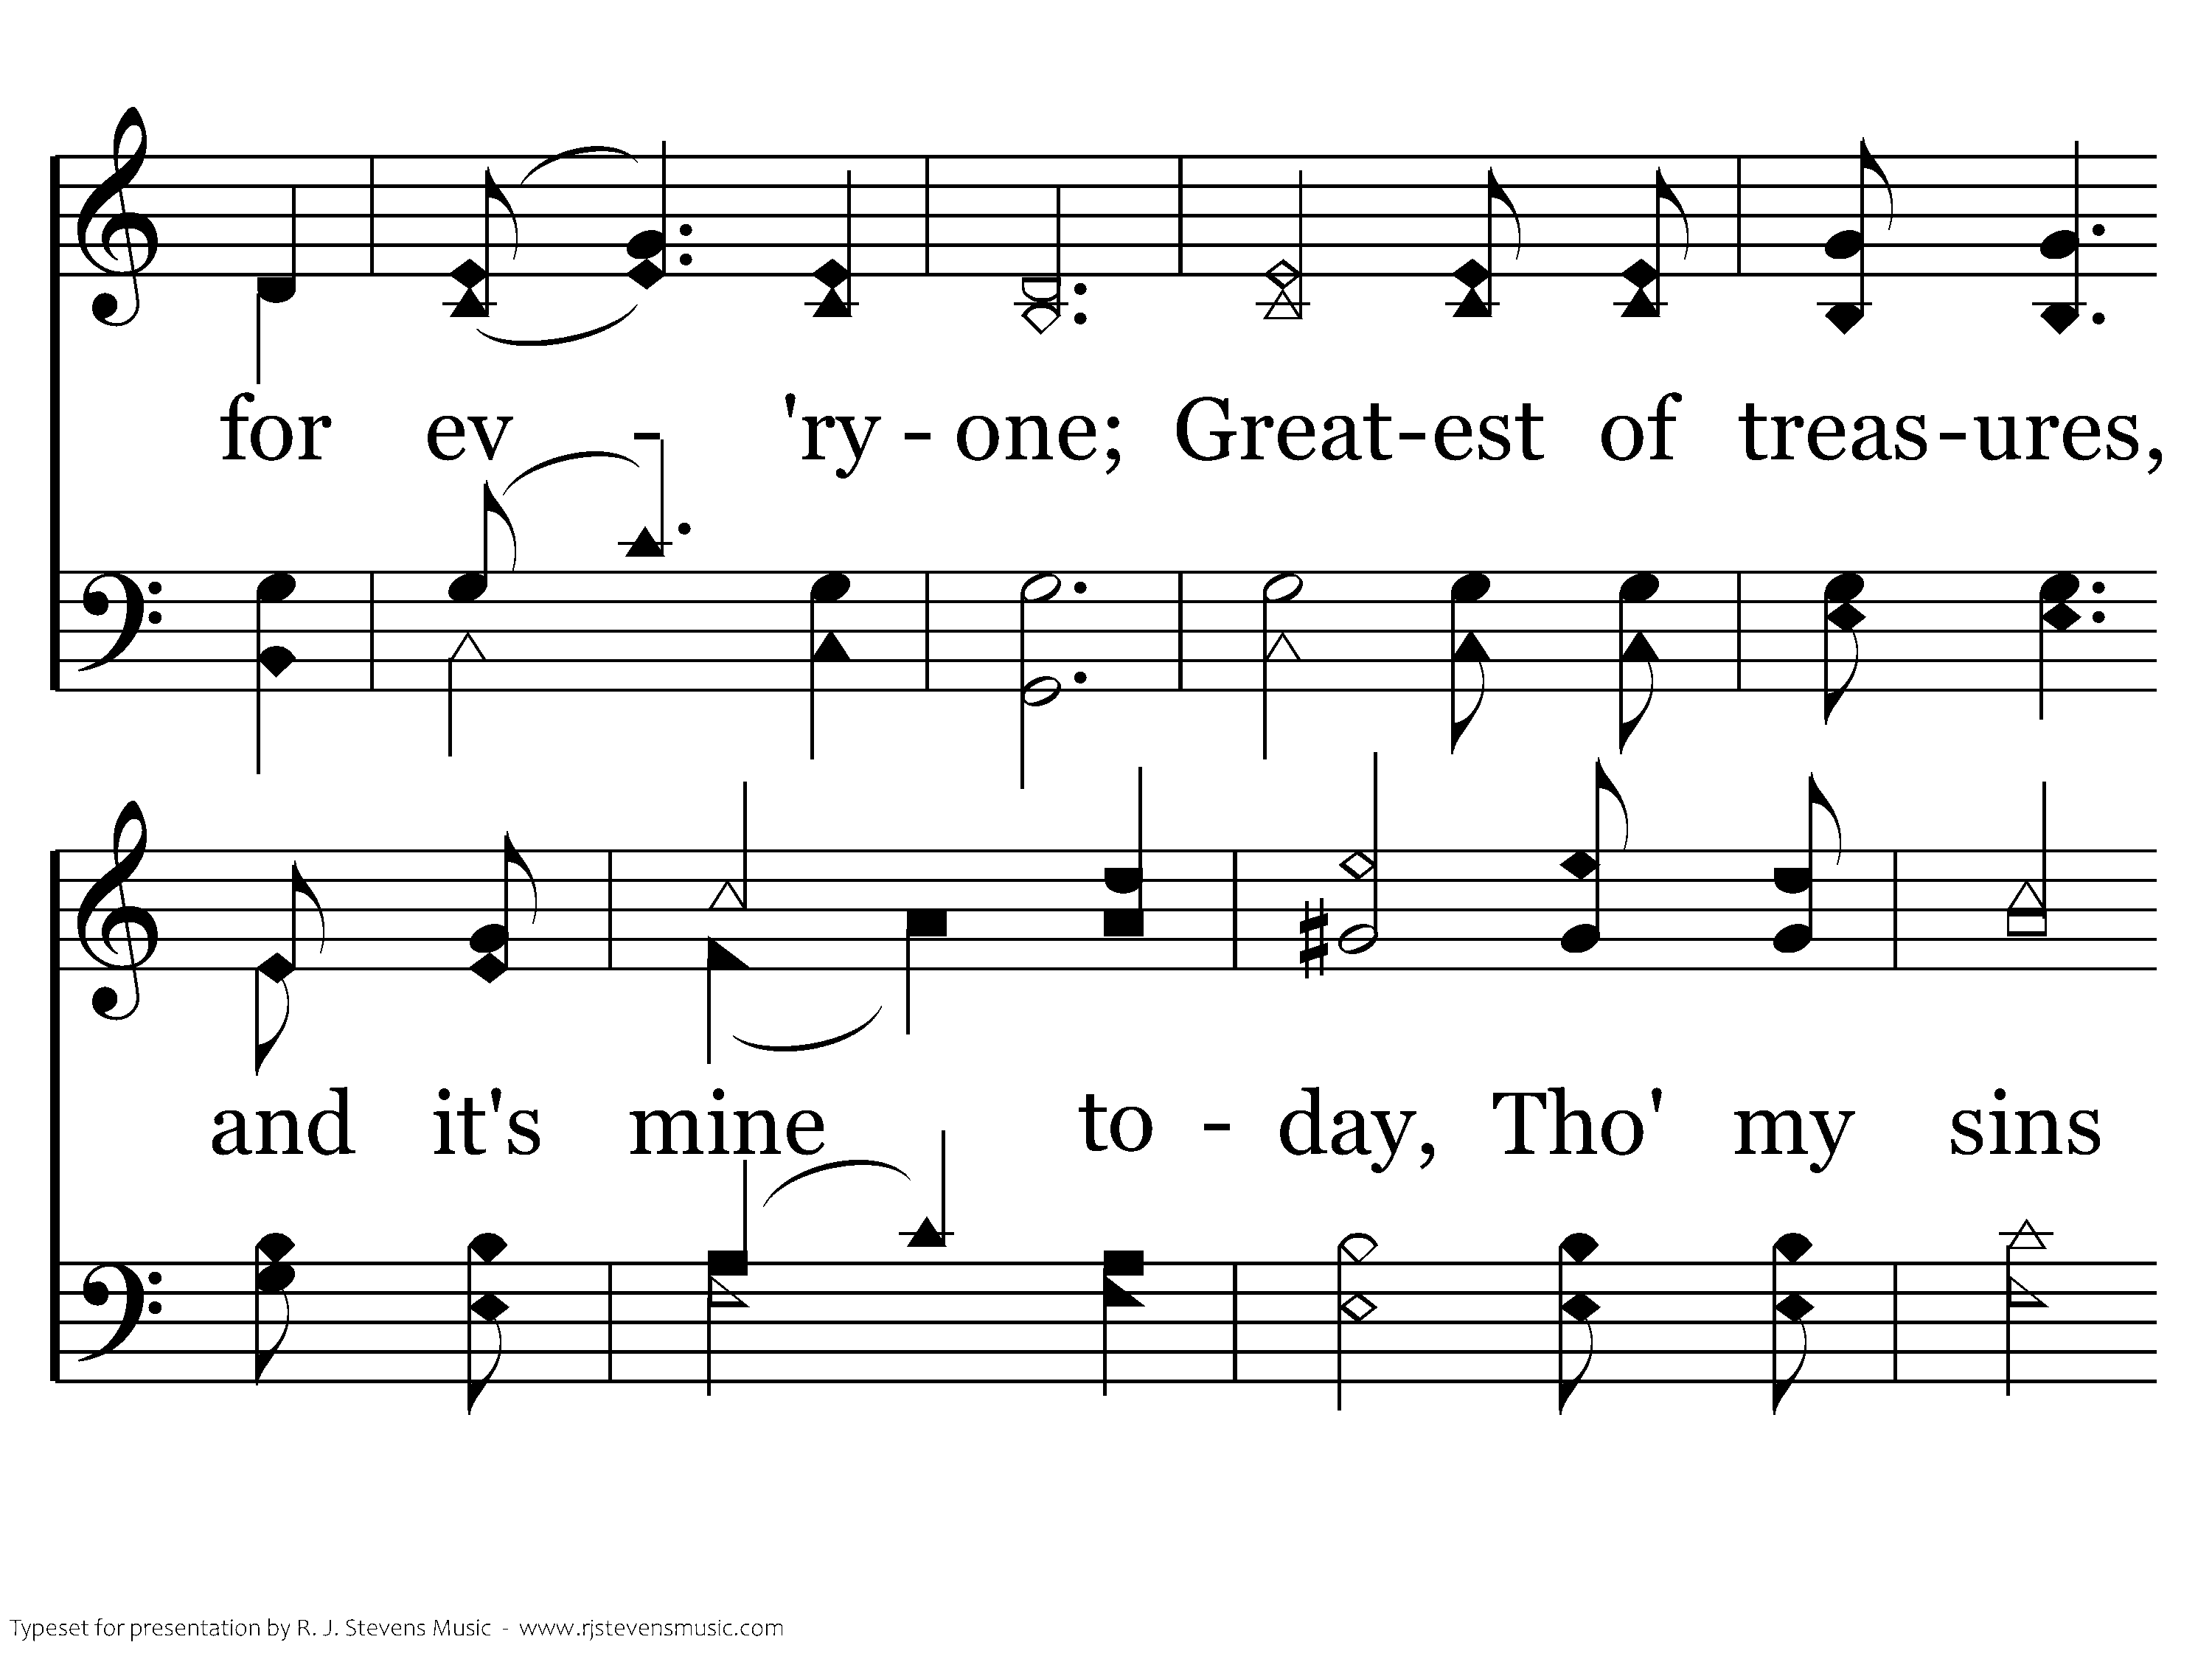
596 - His Grace Reaches Me - 2.2
CCLI #21593236

Slide 45
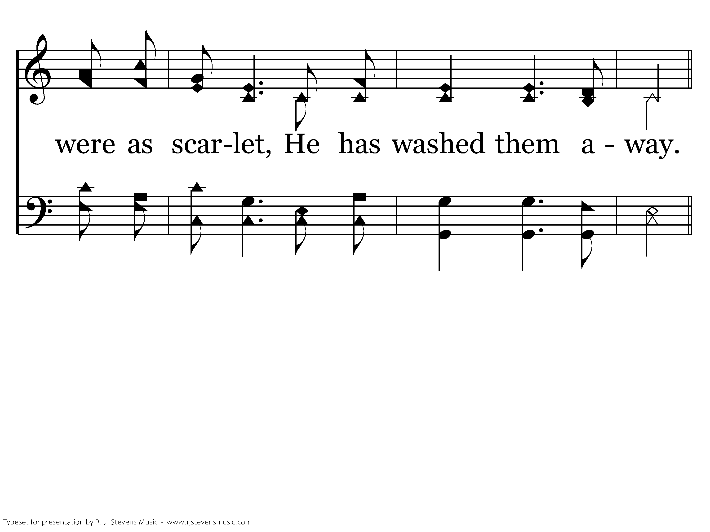
596 - His Grace Reaches Me - 2.3
CCLI #21593236

Slide 46
596 - His Grace Reaches Me - C.1
CCLI #21593236

Slide 47
596 - His Grace Reaches Me - C.2
CCLI #21593236

Slide 48
596 - His Grace Reaches Me - C.3
CCLI #21593236
End of Song

Slide 51
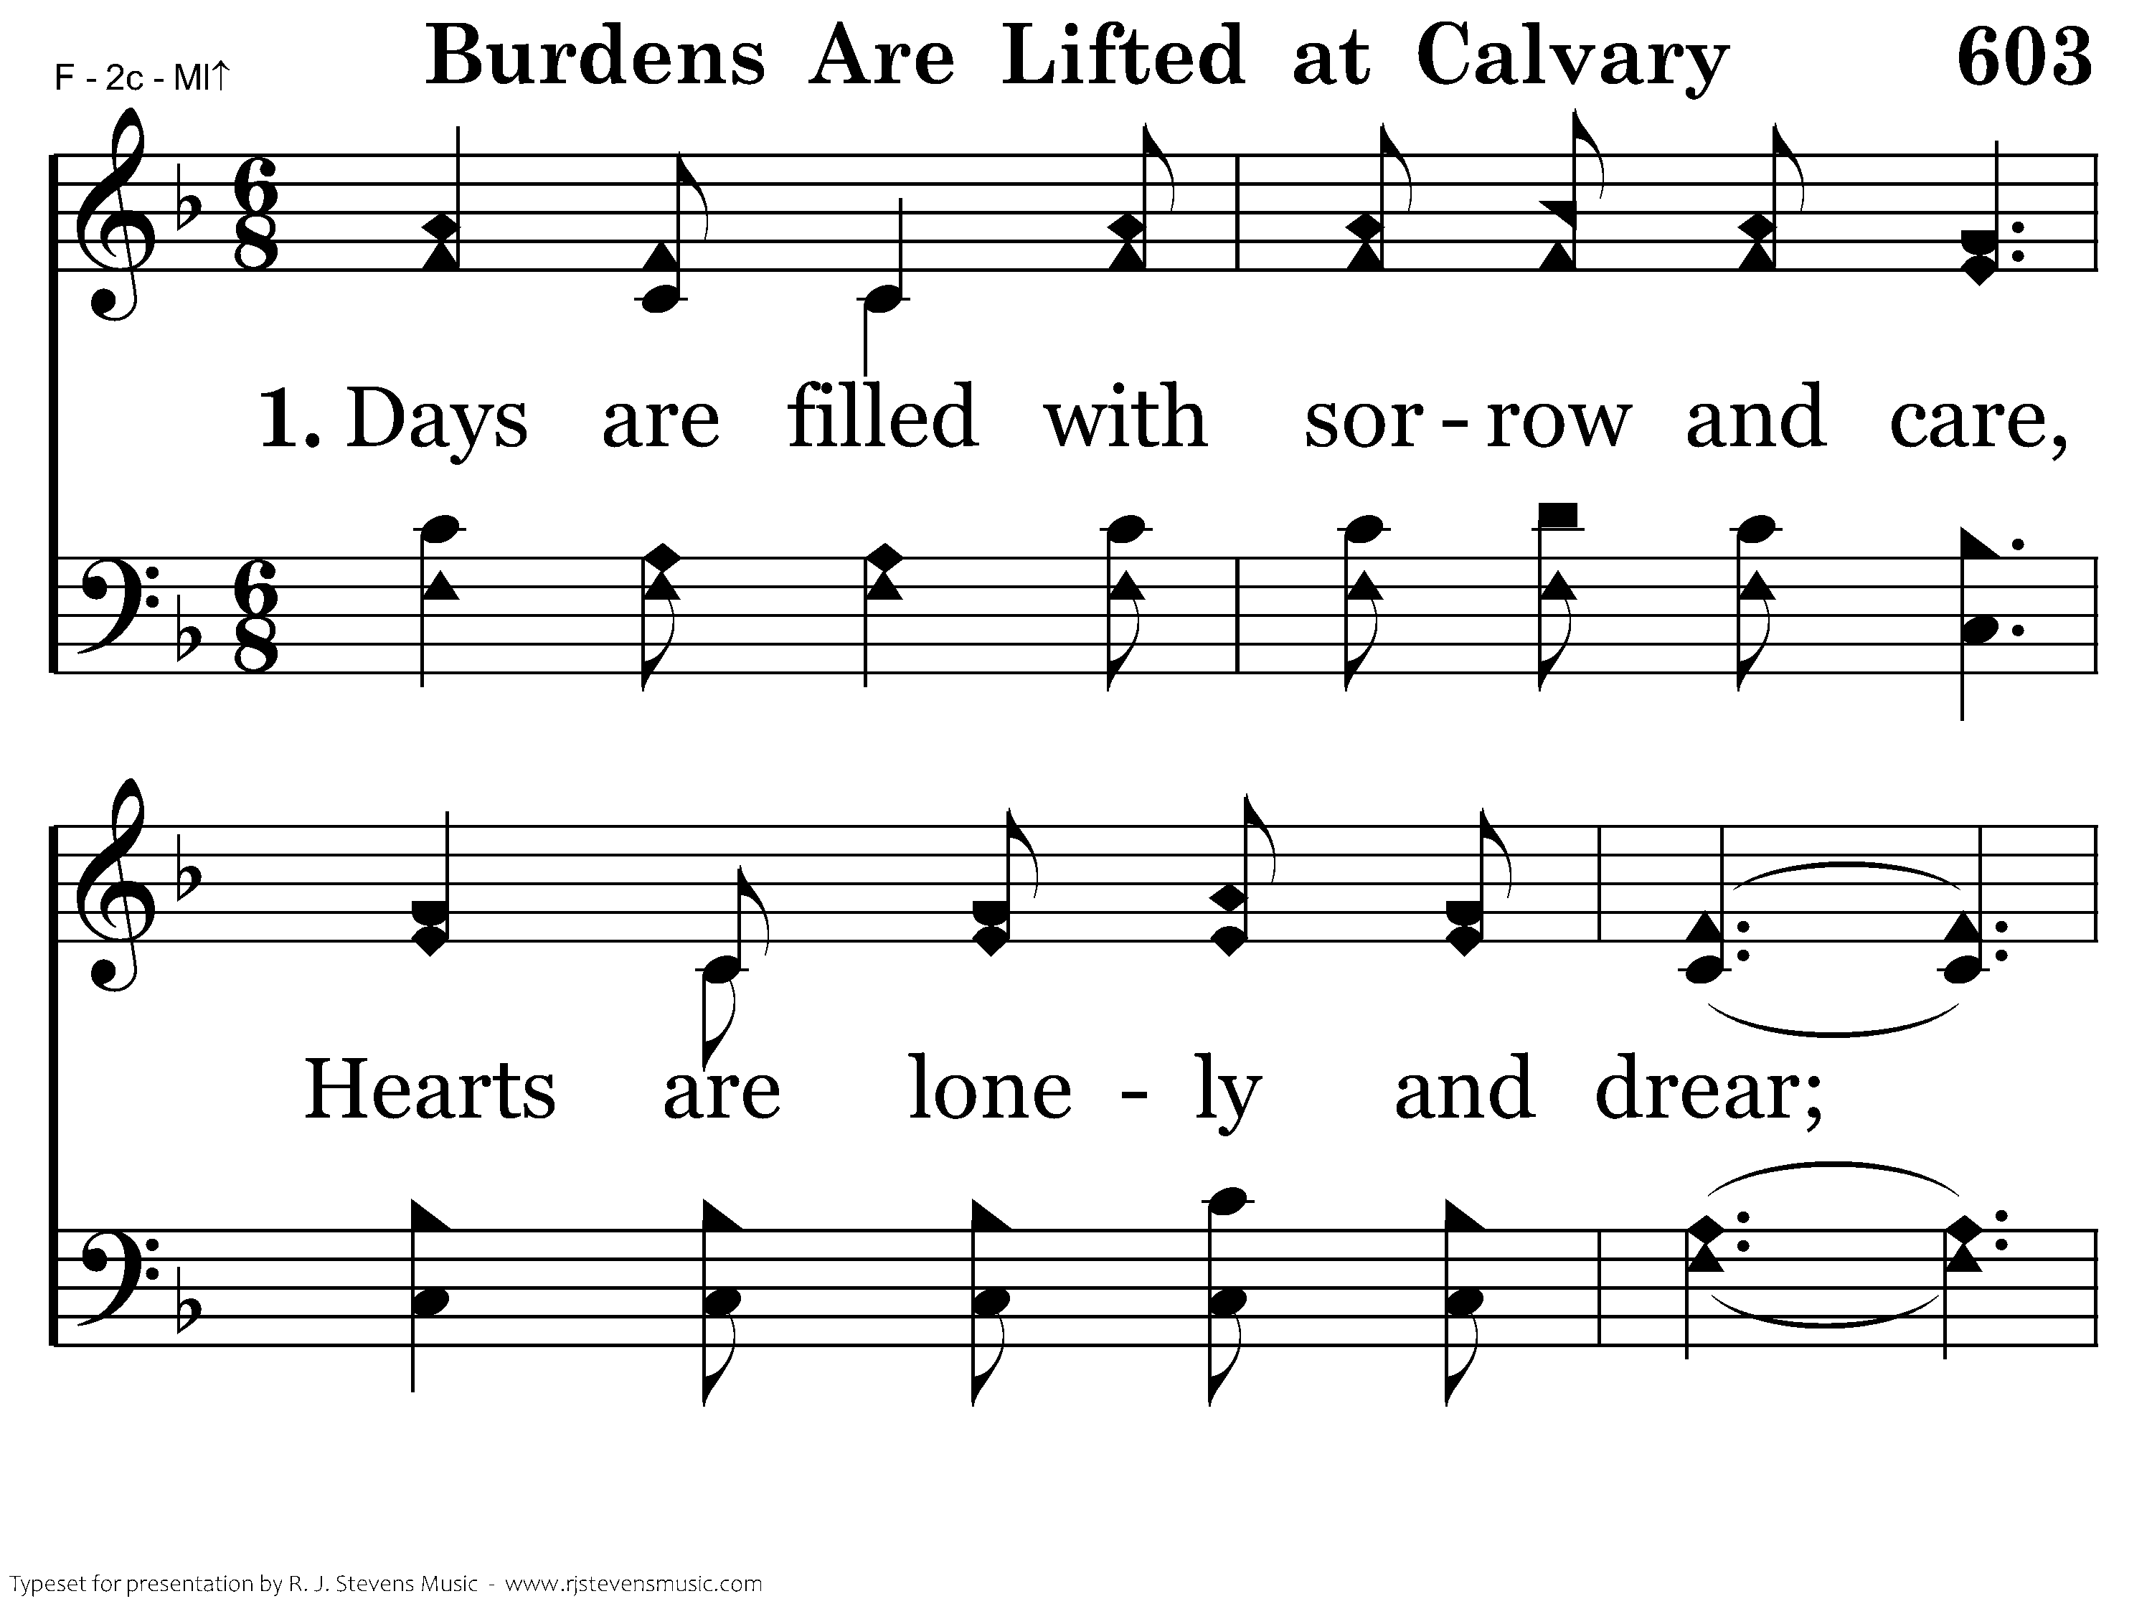
603 - Burdens Are Lifted At Calvary - 1.1
CCLI #21593236

Slide 52
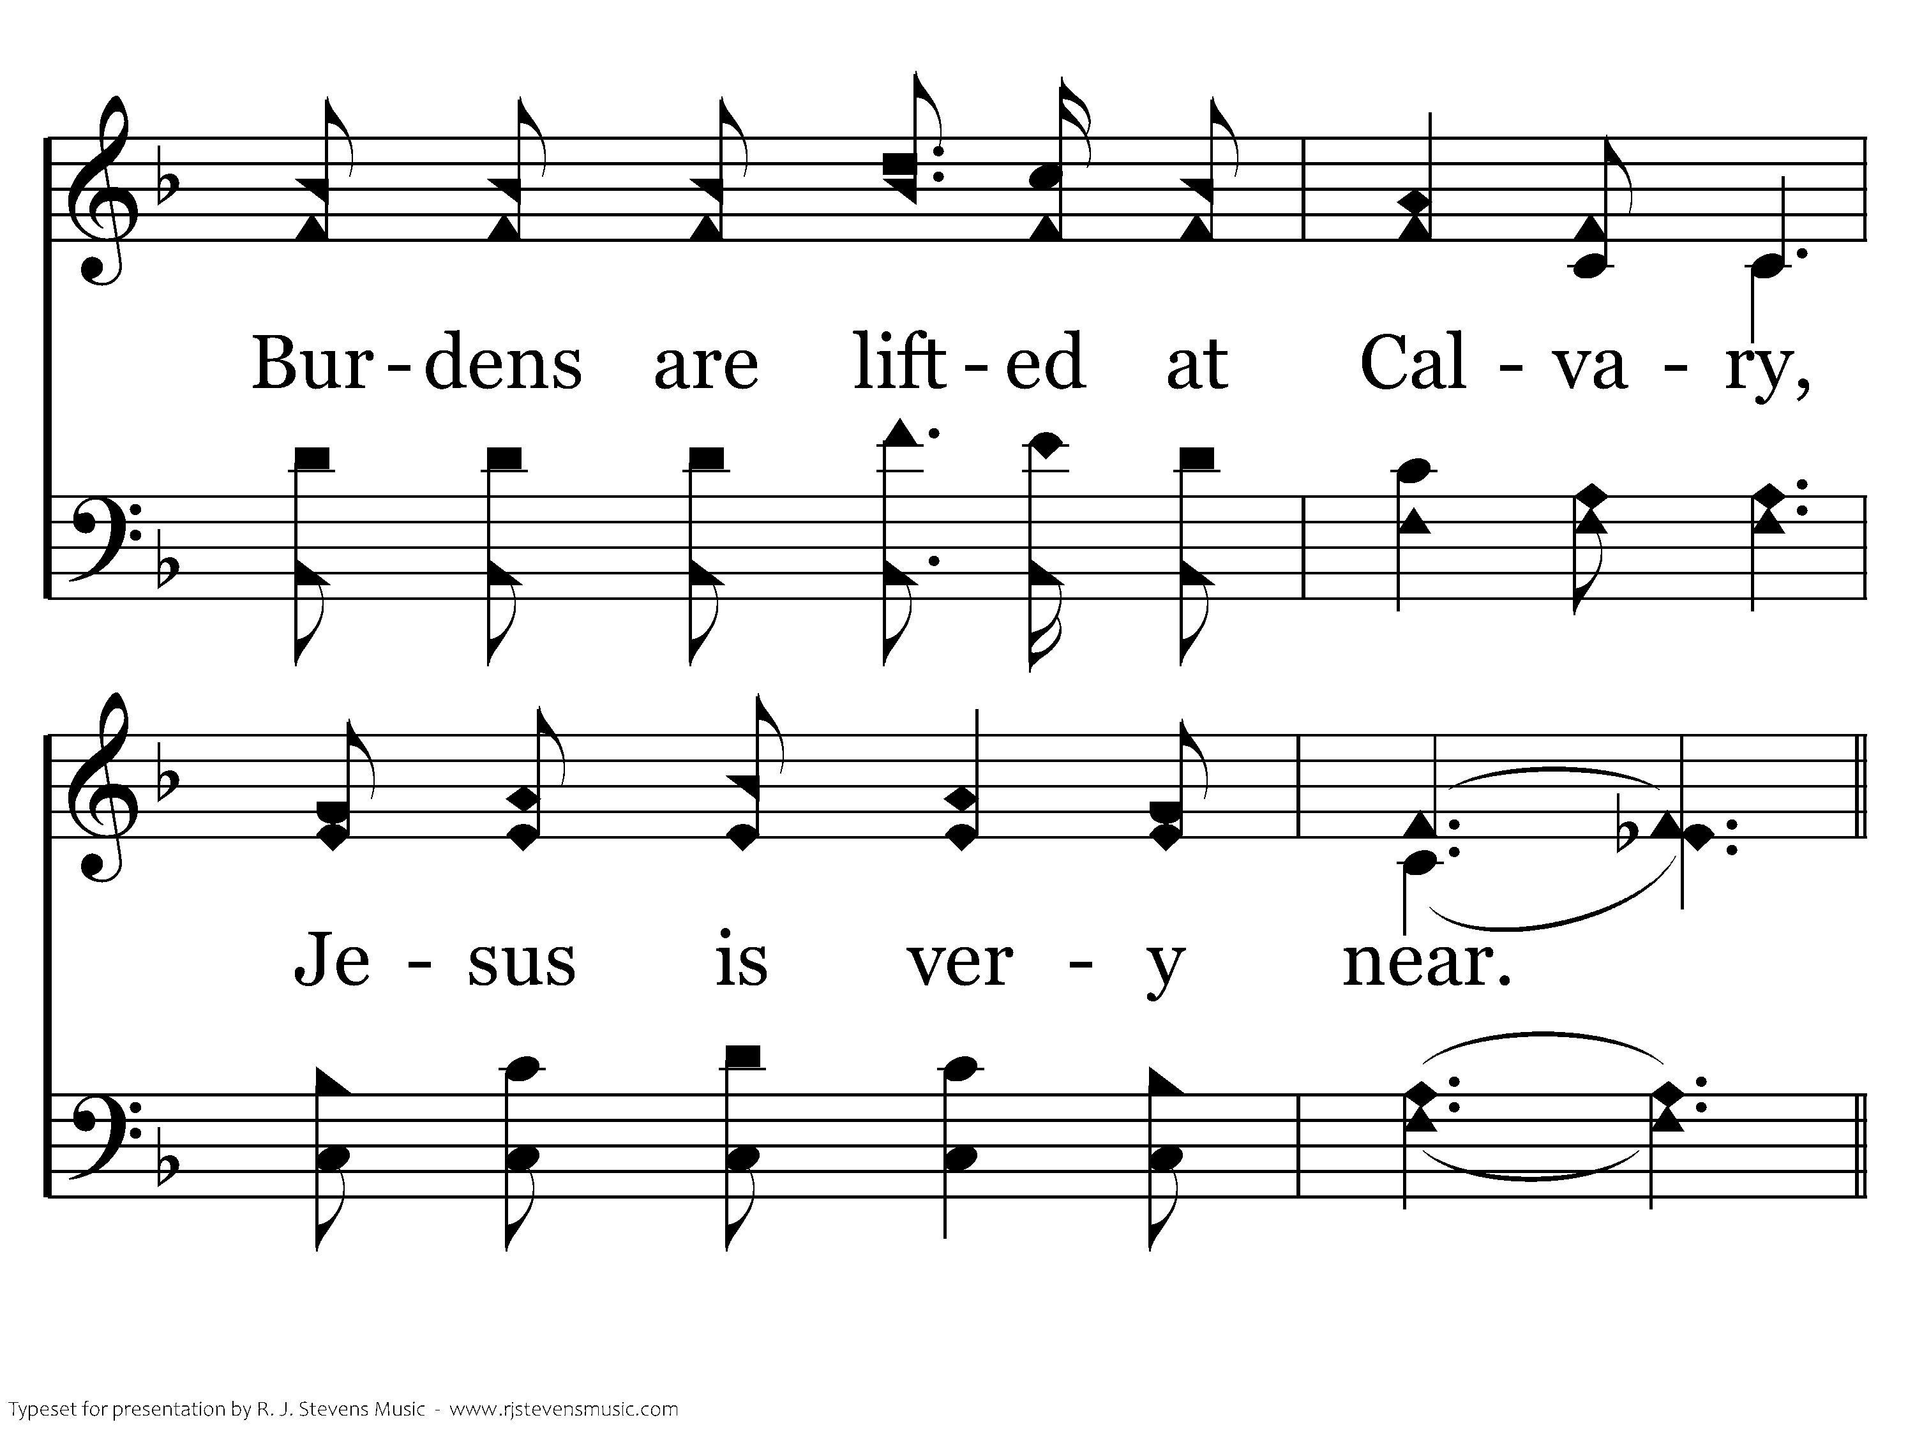
603 - Burdens Are Lifted At Calvary - 1.2
CCLI #21593236

Slide 53
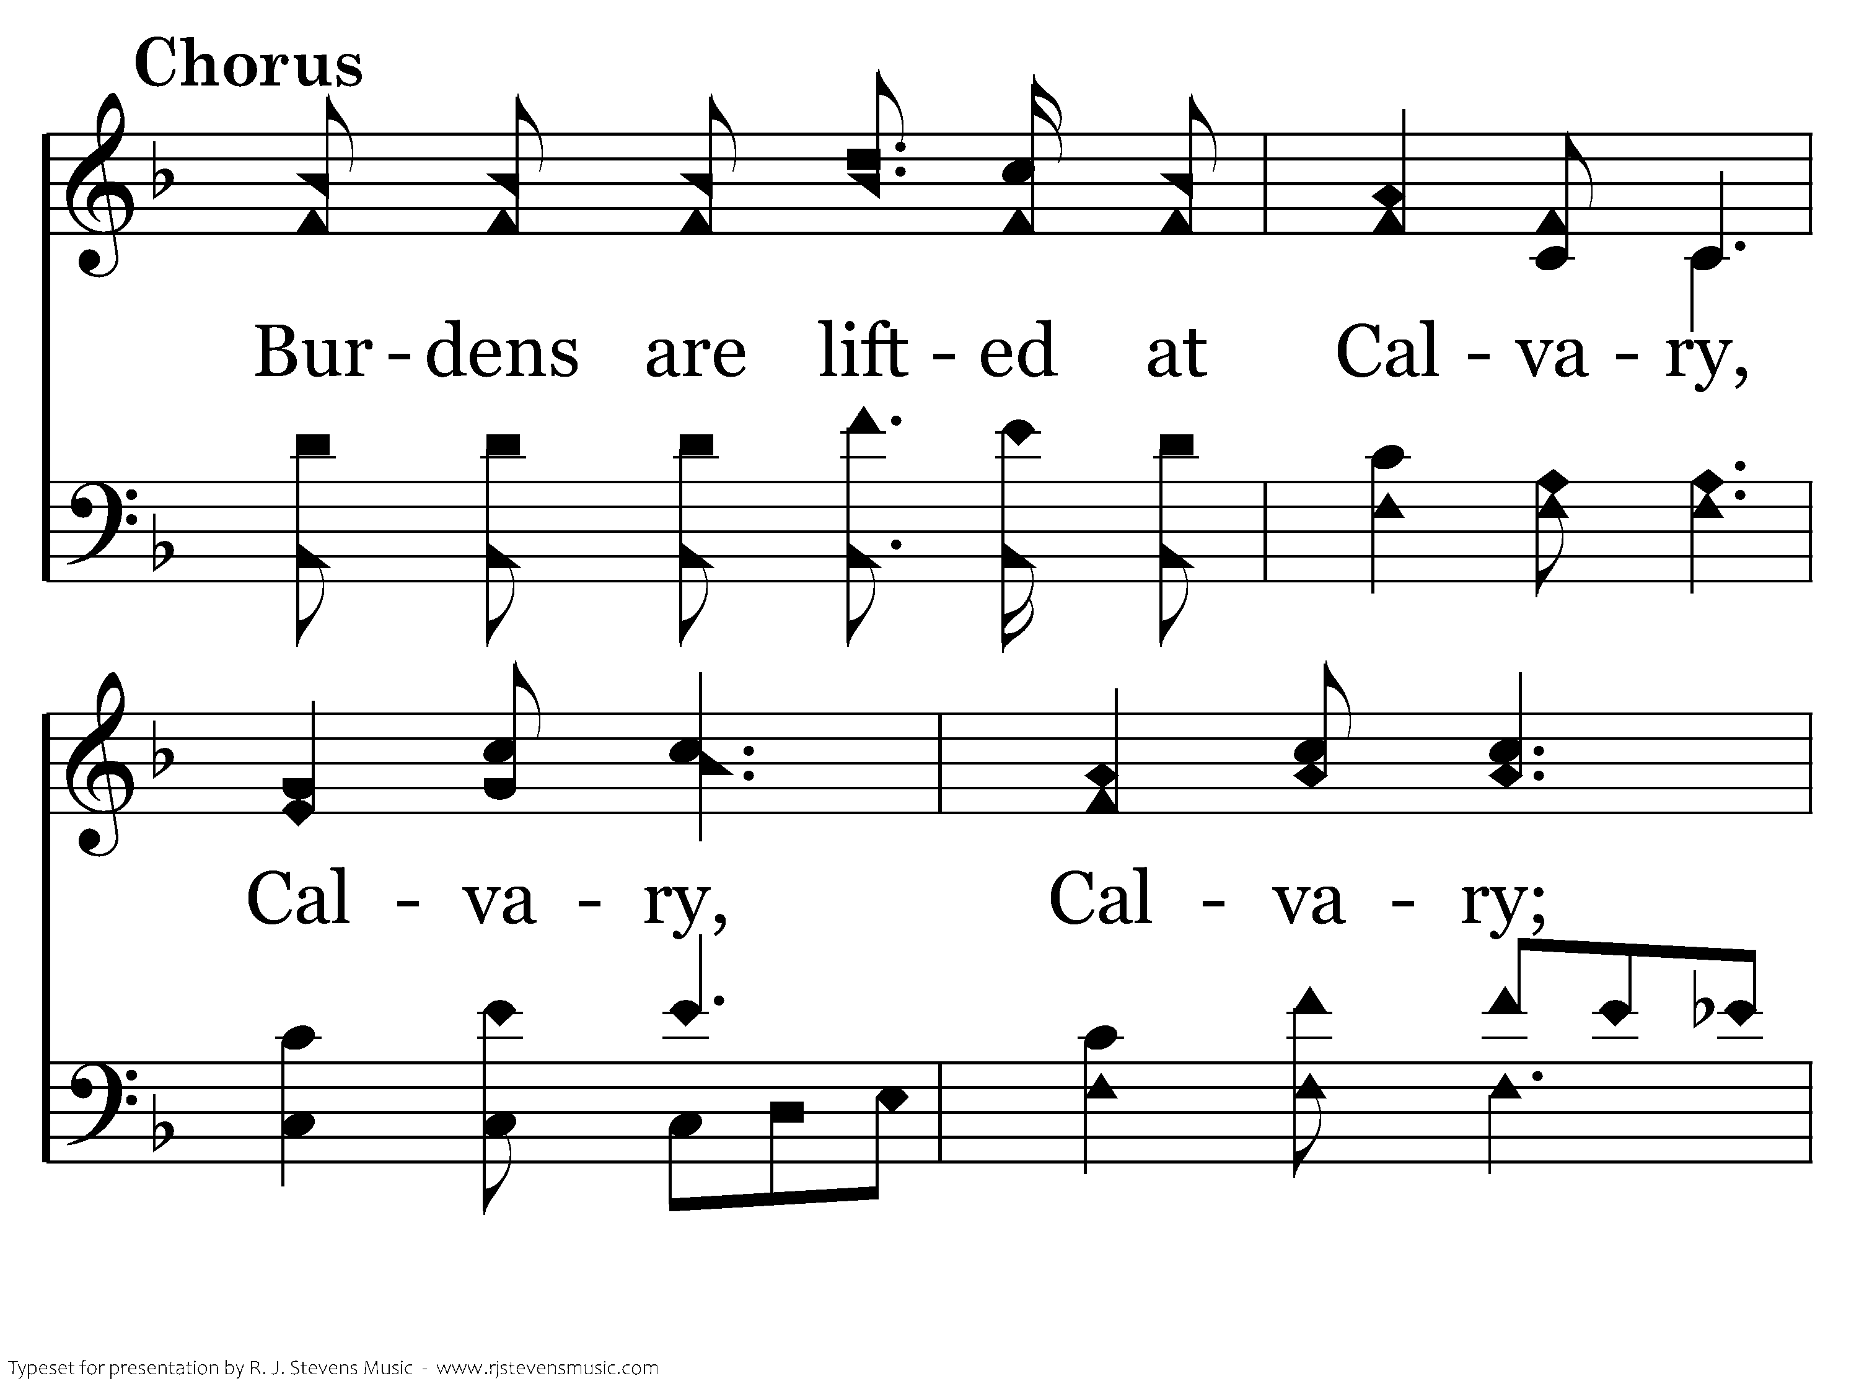
603 - Burdens Are Lifted At Calvary - C.1
CCLI #21593236

Slide 54
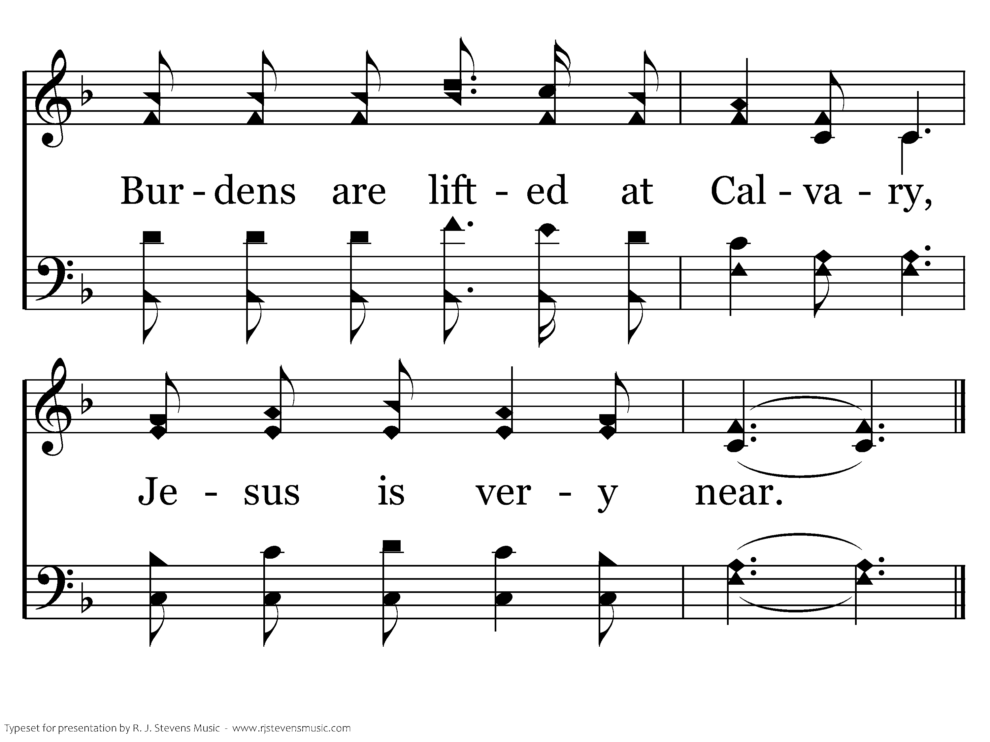
603 - Burdens Are Lifted At Calvary - C.2
CCLI #21593236
End of Verse 1

Slide 55
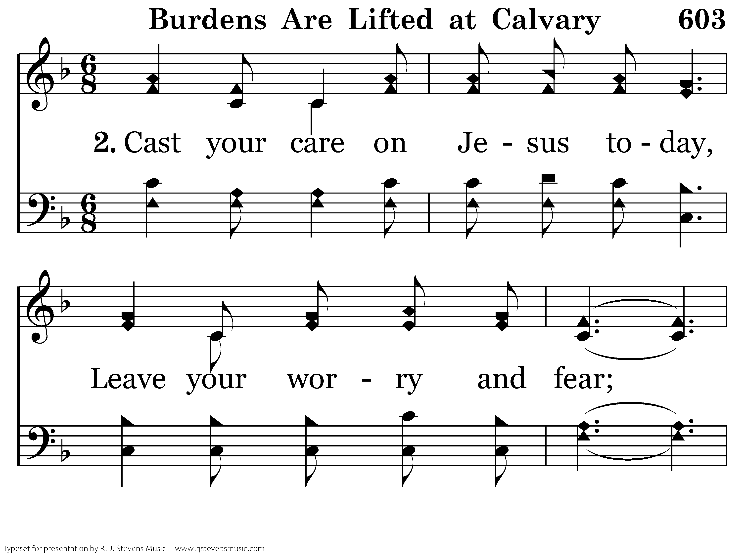
603 - Burdens Are Lifted At Calvary - 2.1
CCLI #21593236

Slide 56

603 - Burdens Are Lifted At Calvary - 2.2
CCLI #21593236

Slide 57
603 - Burdens Are Lifted At Calvary - C.1
CCLI #21593236

Slide 58
603 - Burdens Are Lifted At Calvary - C.2
CCLI #21593236
End of Verse 2

Slide 59
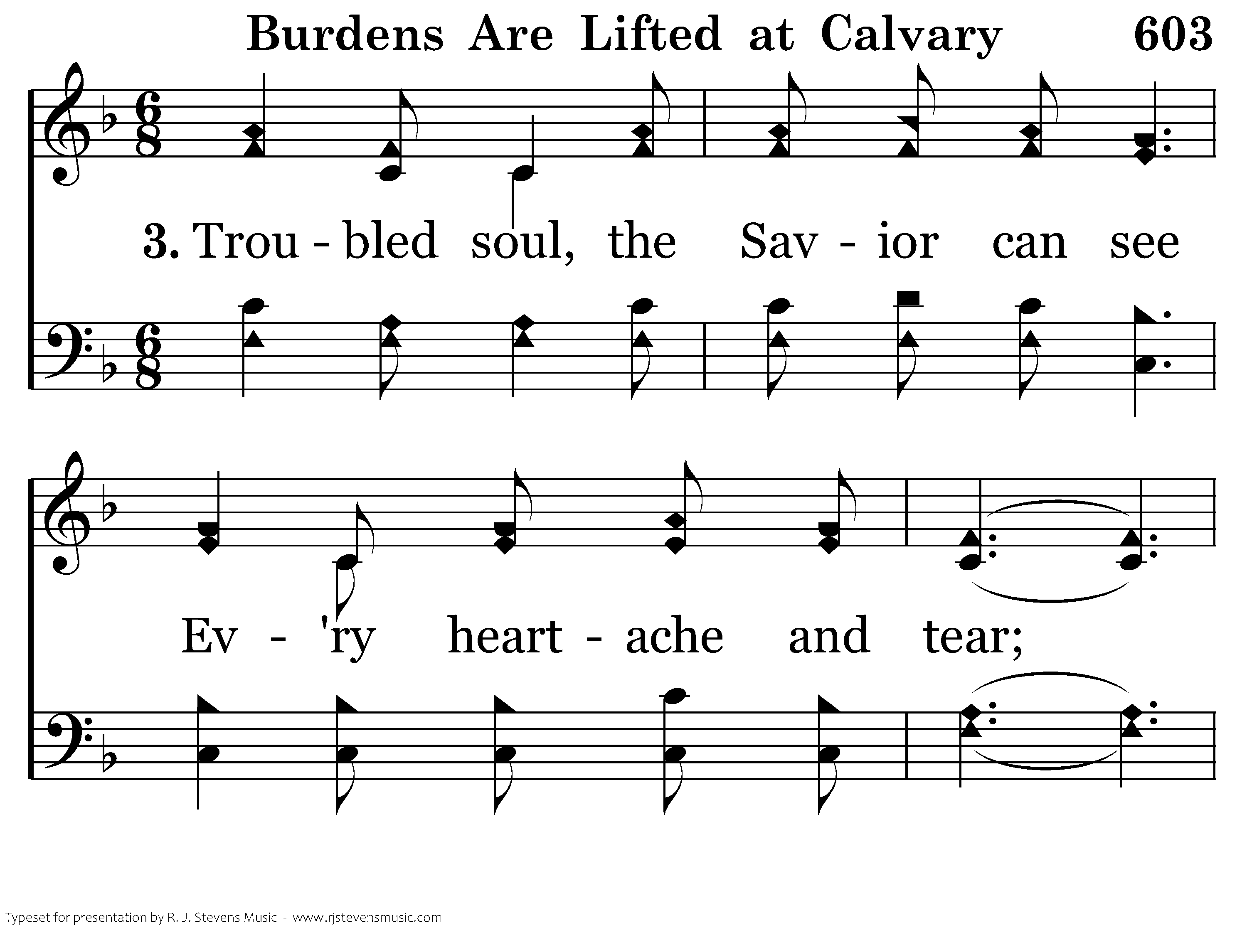
603 - Burdens Are Lifted At Calvary - 3.1
CCLI #21593236

Slide 60
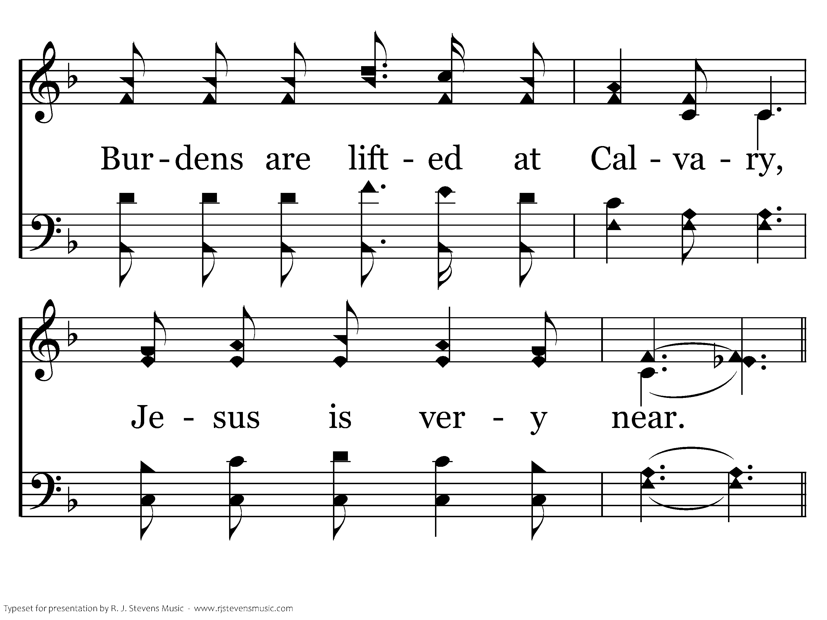
603 - Burdens Are Lifted At Calvary - 3.2
CCLI #21593236

Slide 61
603 - Burdens Are Lifted At Calvary - C.1
CCLI #21593236

Slide 62
603 - Burdens Are Lifted At Calvary - C.2
CCLI #21593236
End of Song

Slide 64
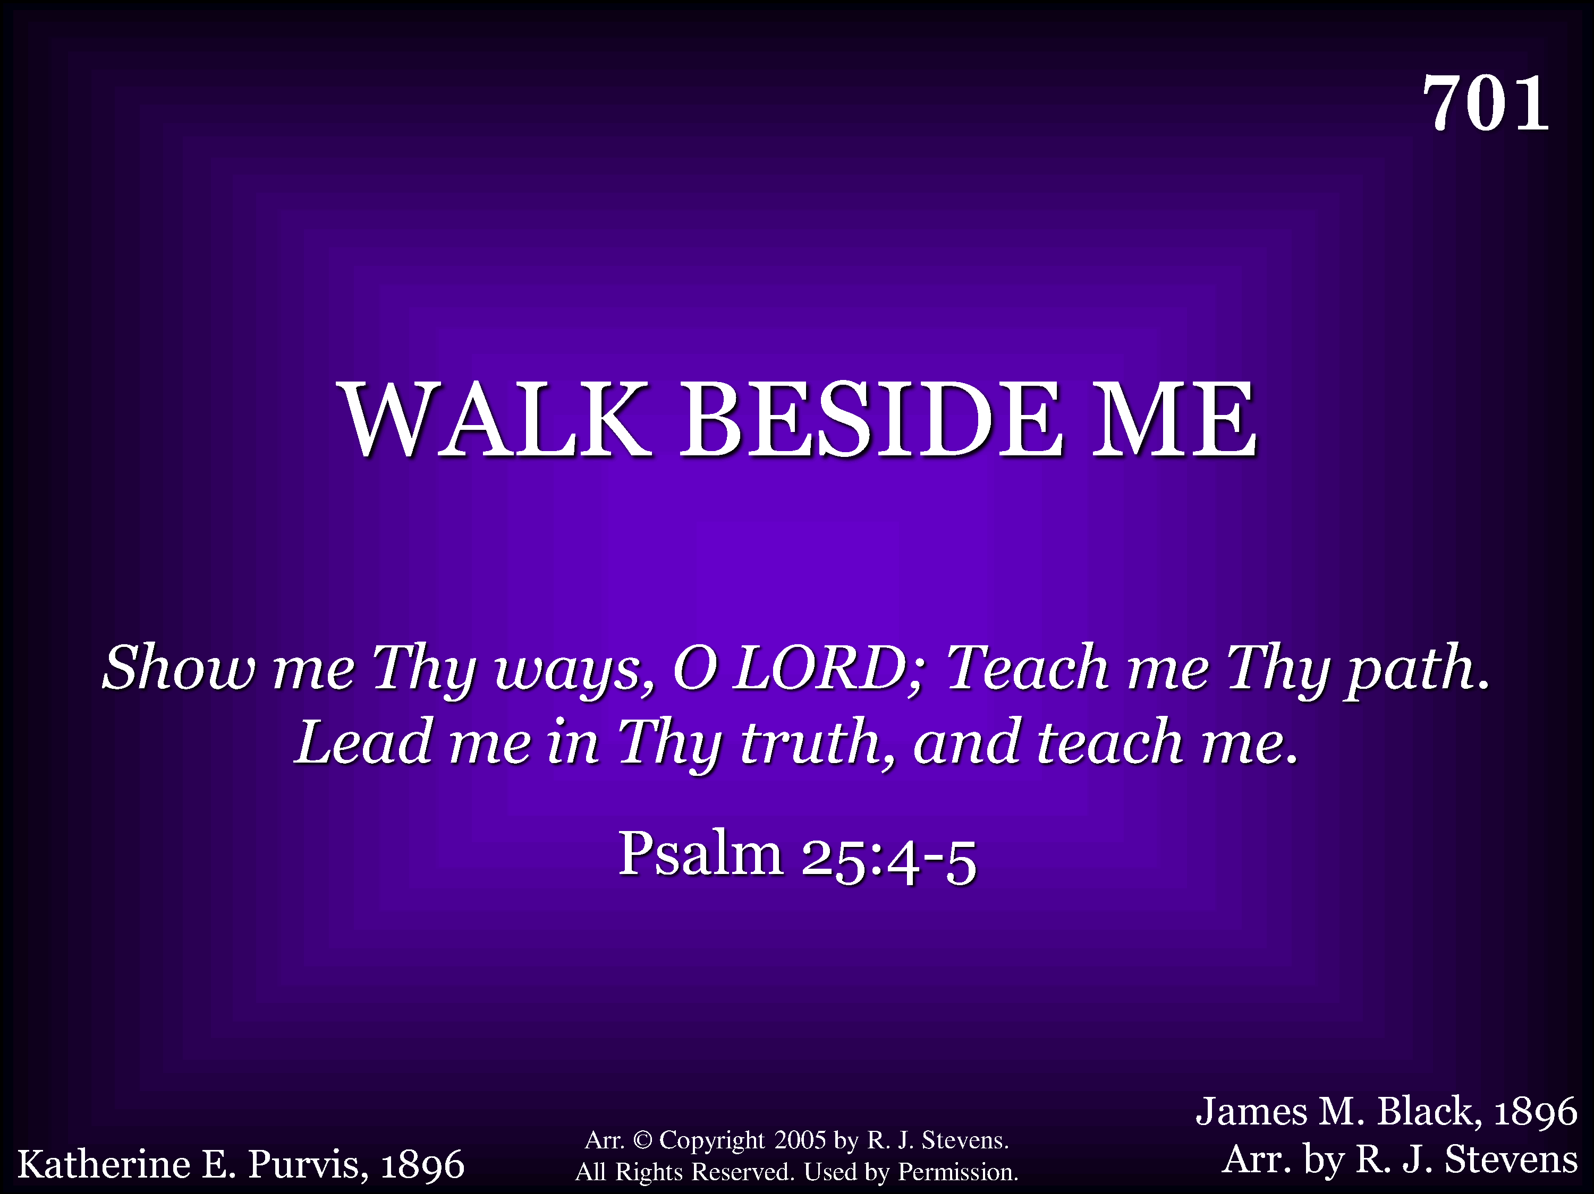
701 - Walk Beside Me - Title
CCLI #21593236

Slide 65
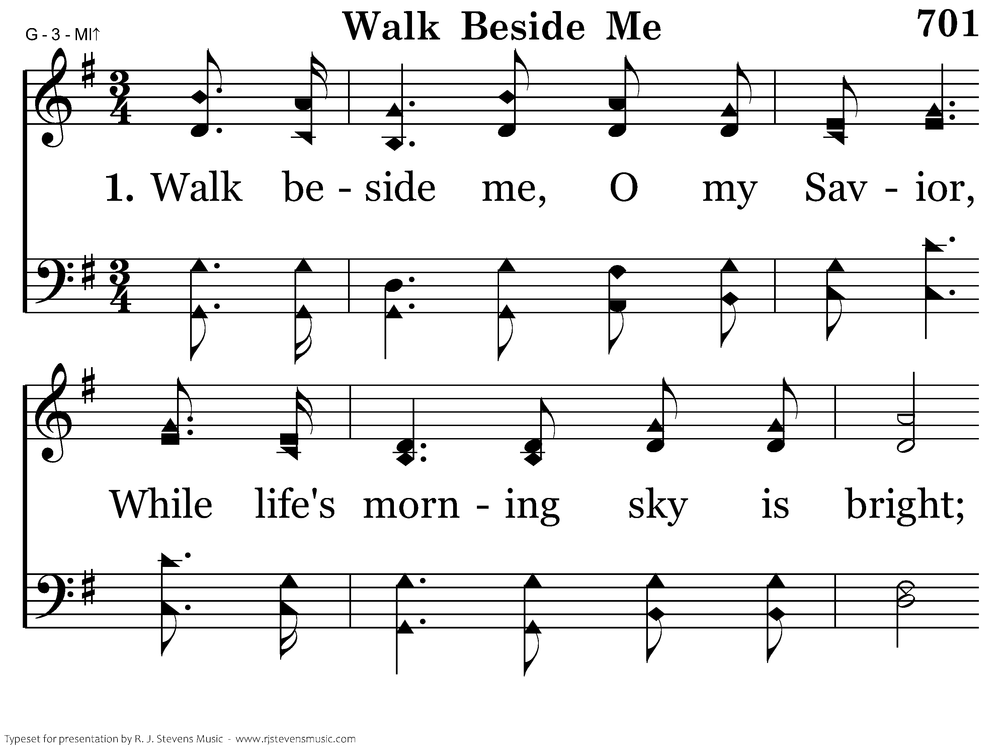
701 - Walk Beside Me - 1.1
CCLI #21593236

Slide 66
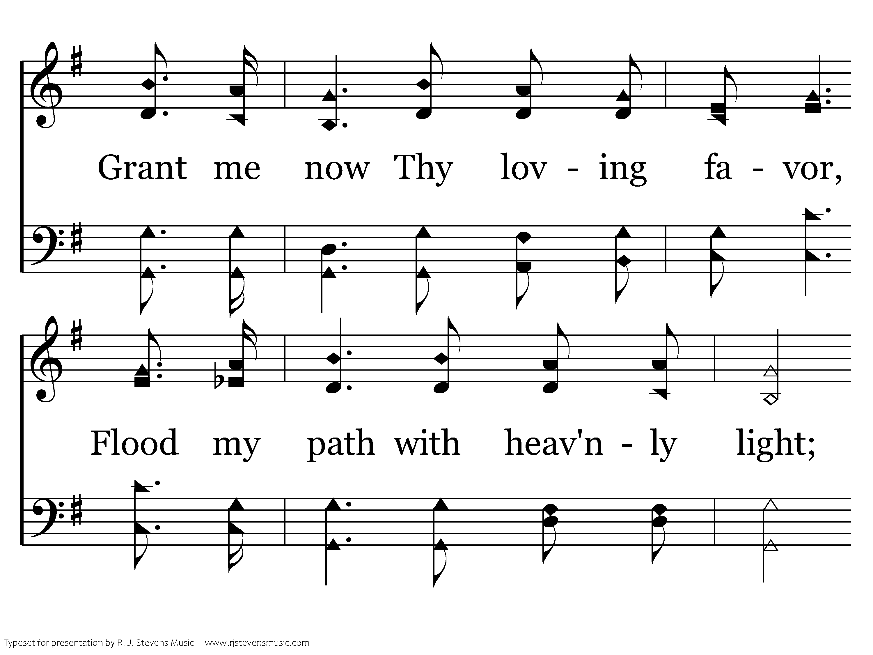
701 - Walk Beside Me - 1.2
CCLI #21593236

Slide 67
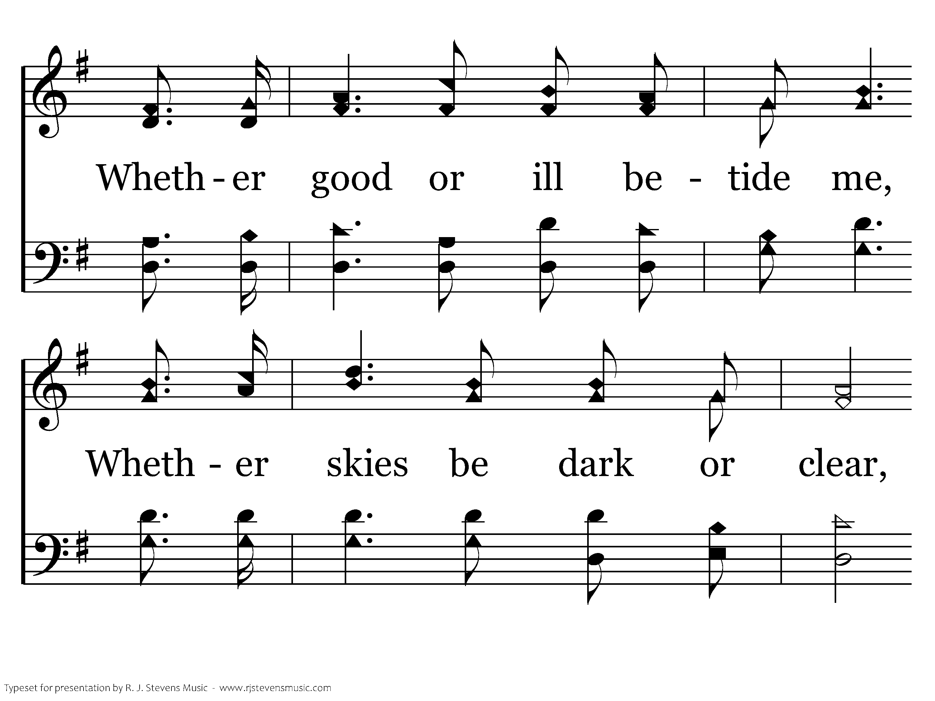
701 - Walk Beside Me - 1.3
CCLI #21593236

Slide 68
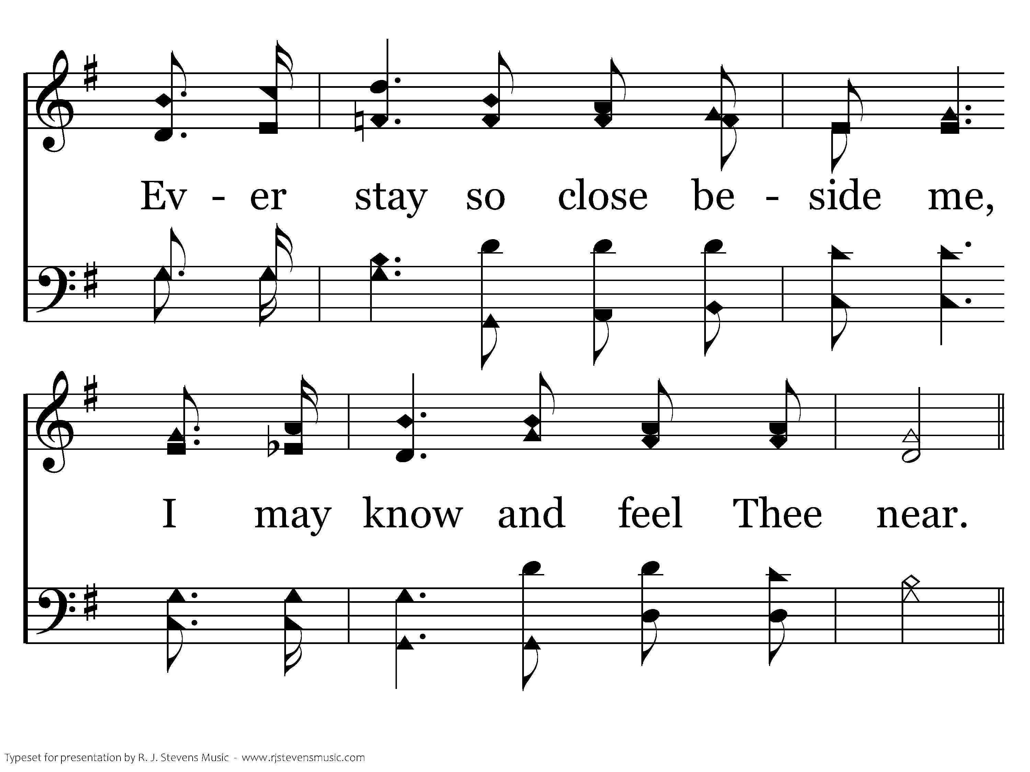
701 - Walk Beside Me - 1.4
CCLI #21593236

Slide 69
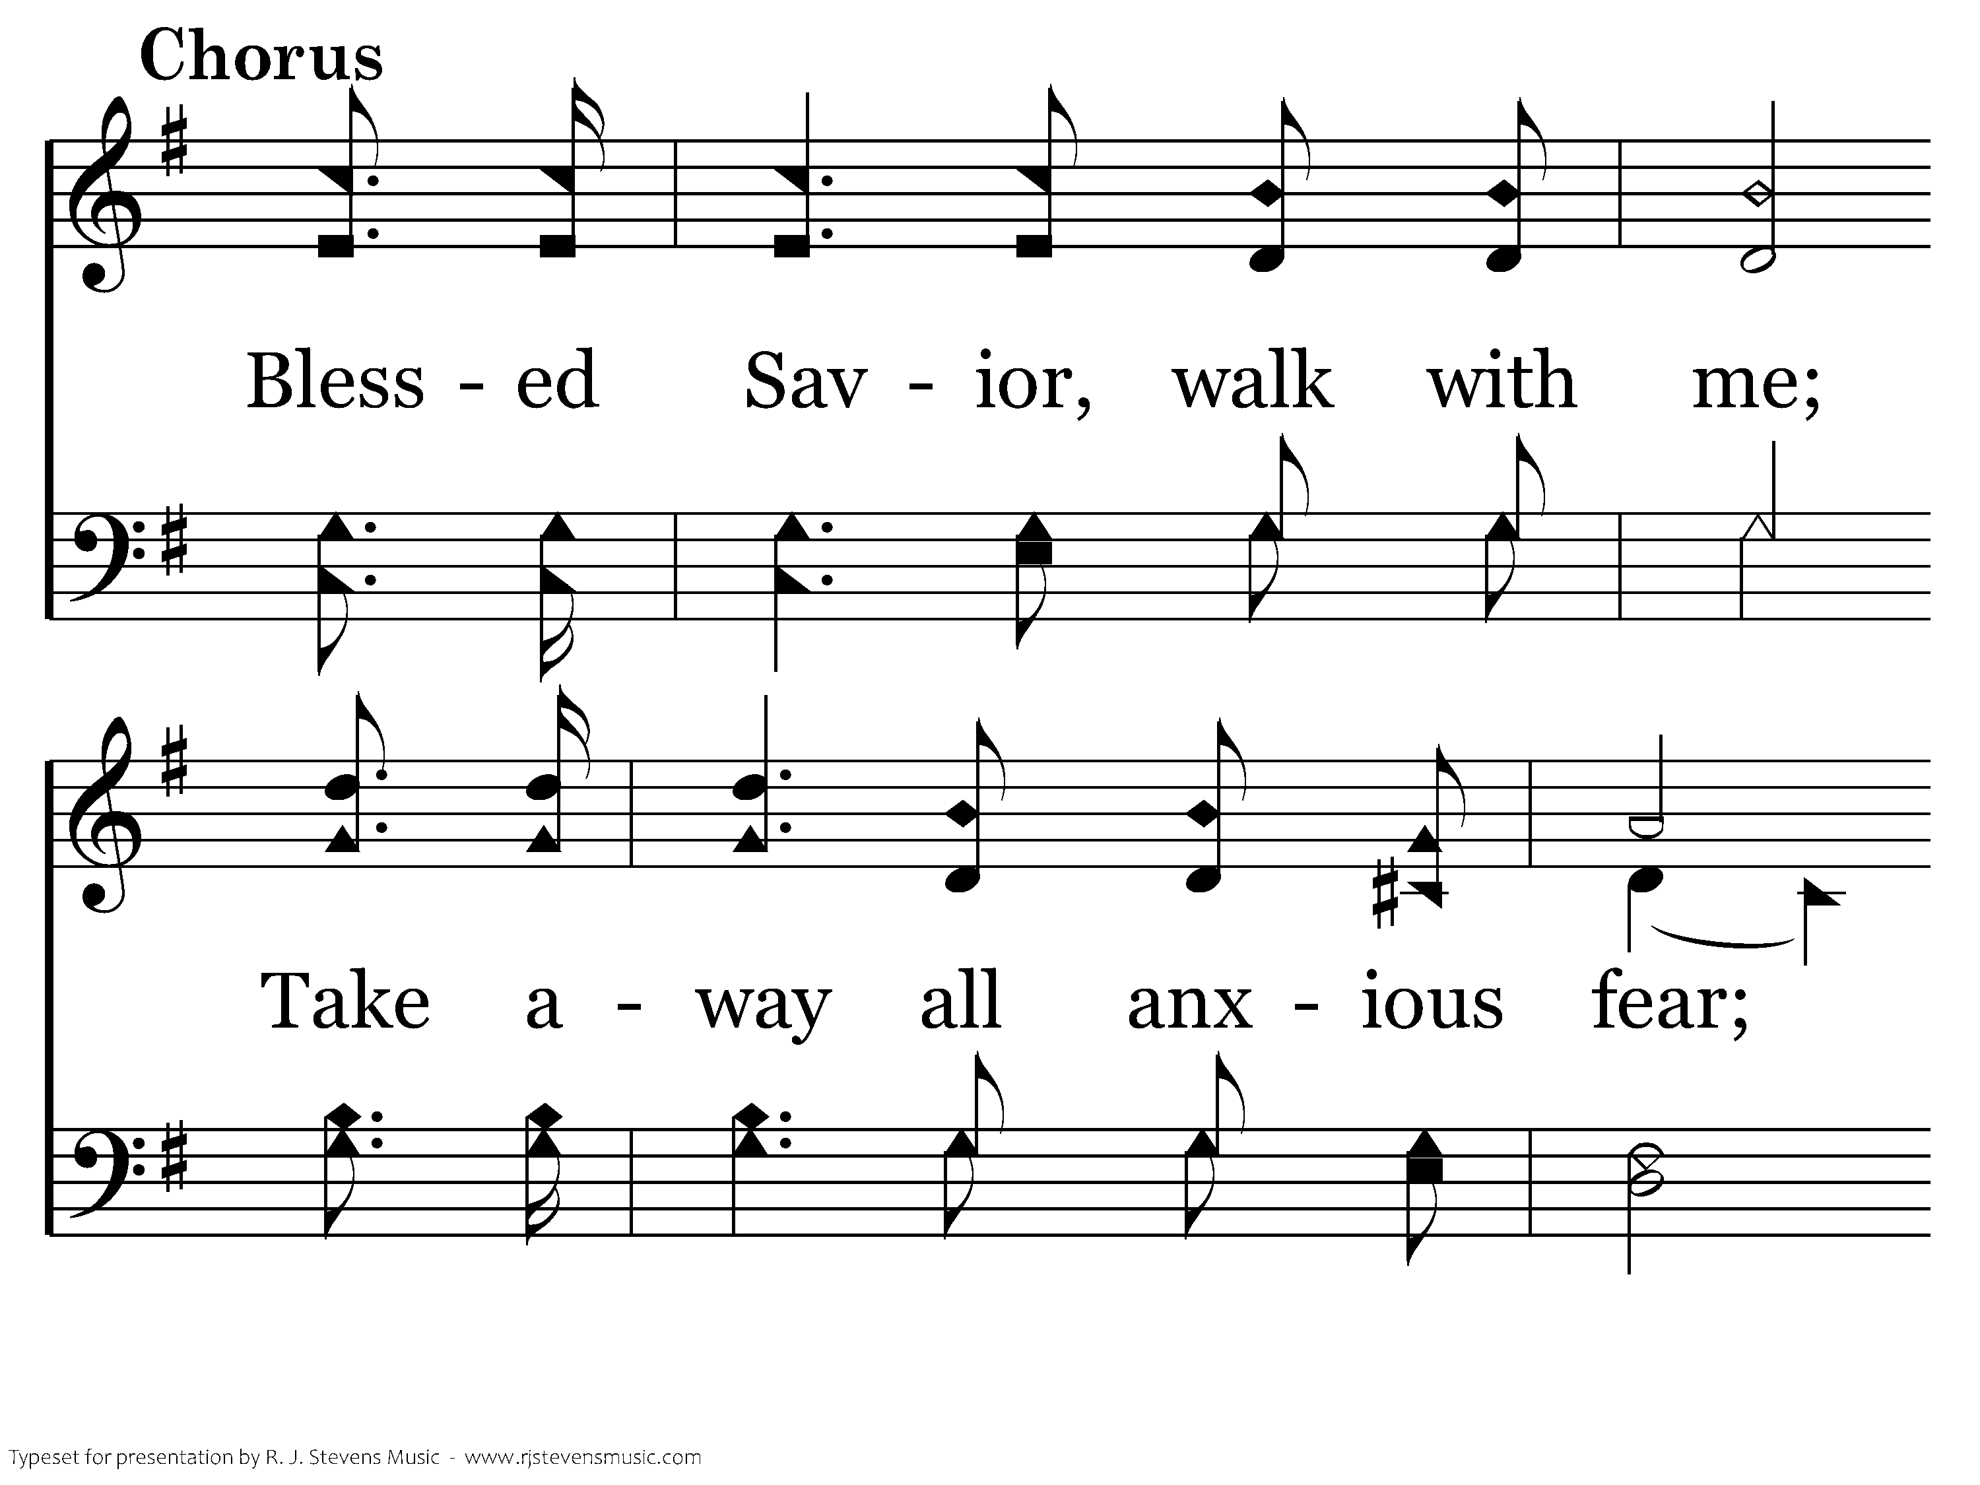
701 - Walk Beside Me - C.1
CCLI #21593236

Slide 70
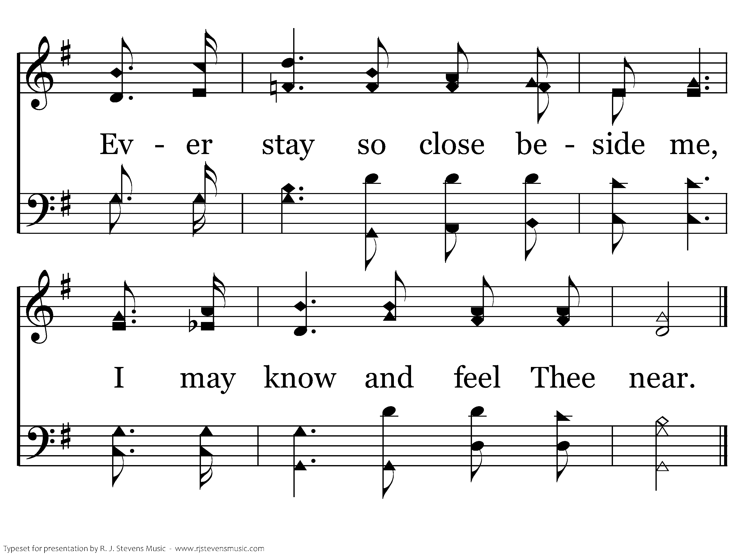
701 - Walk Beside Me - C.2
CCLI #21593236
End of Verse 1

Slide 71
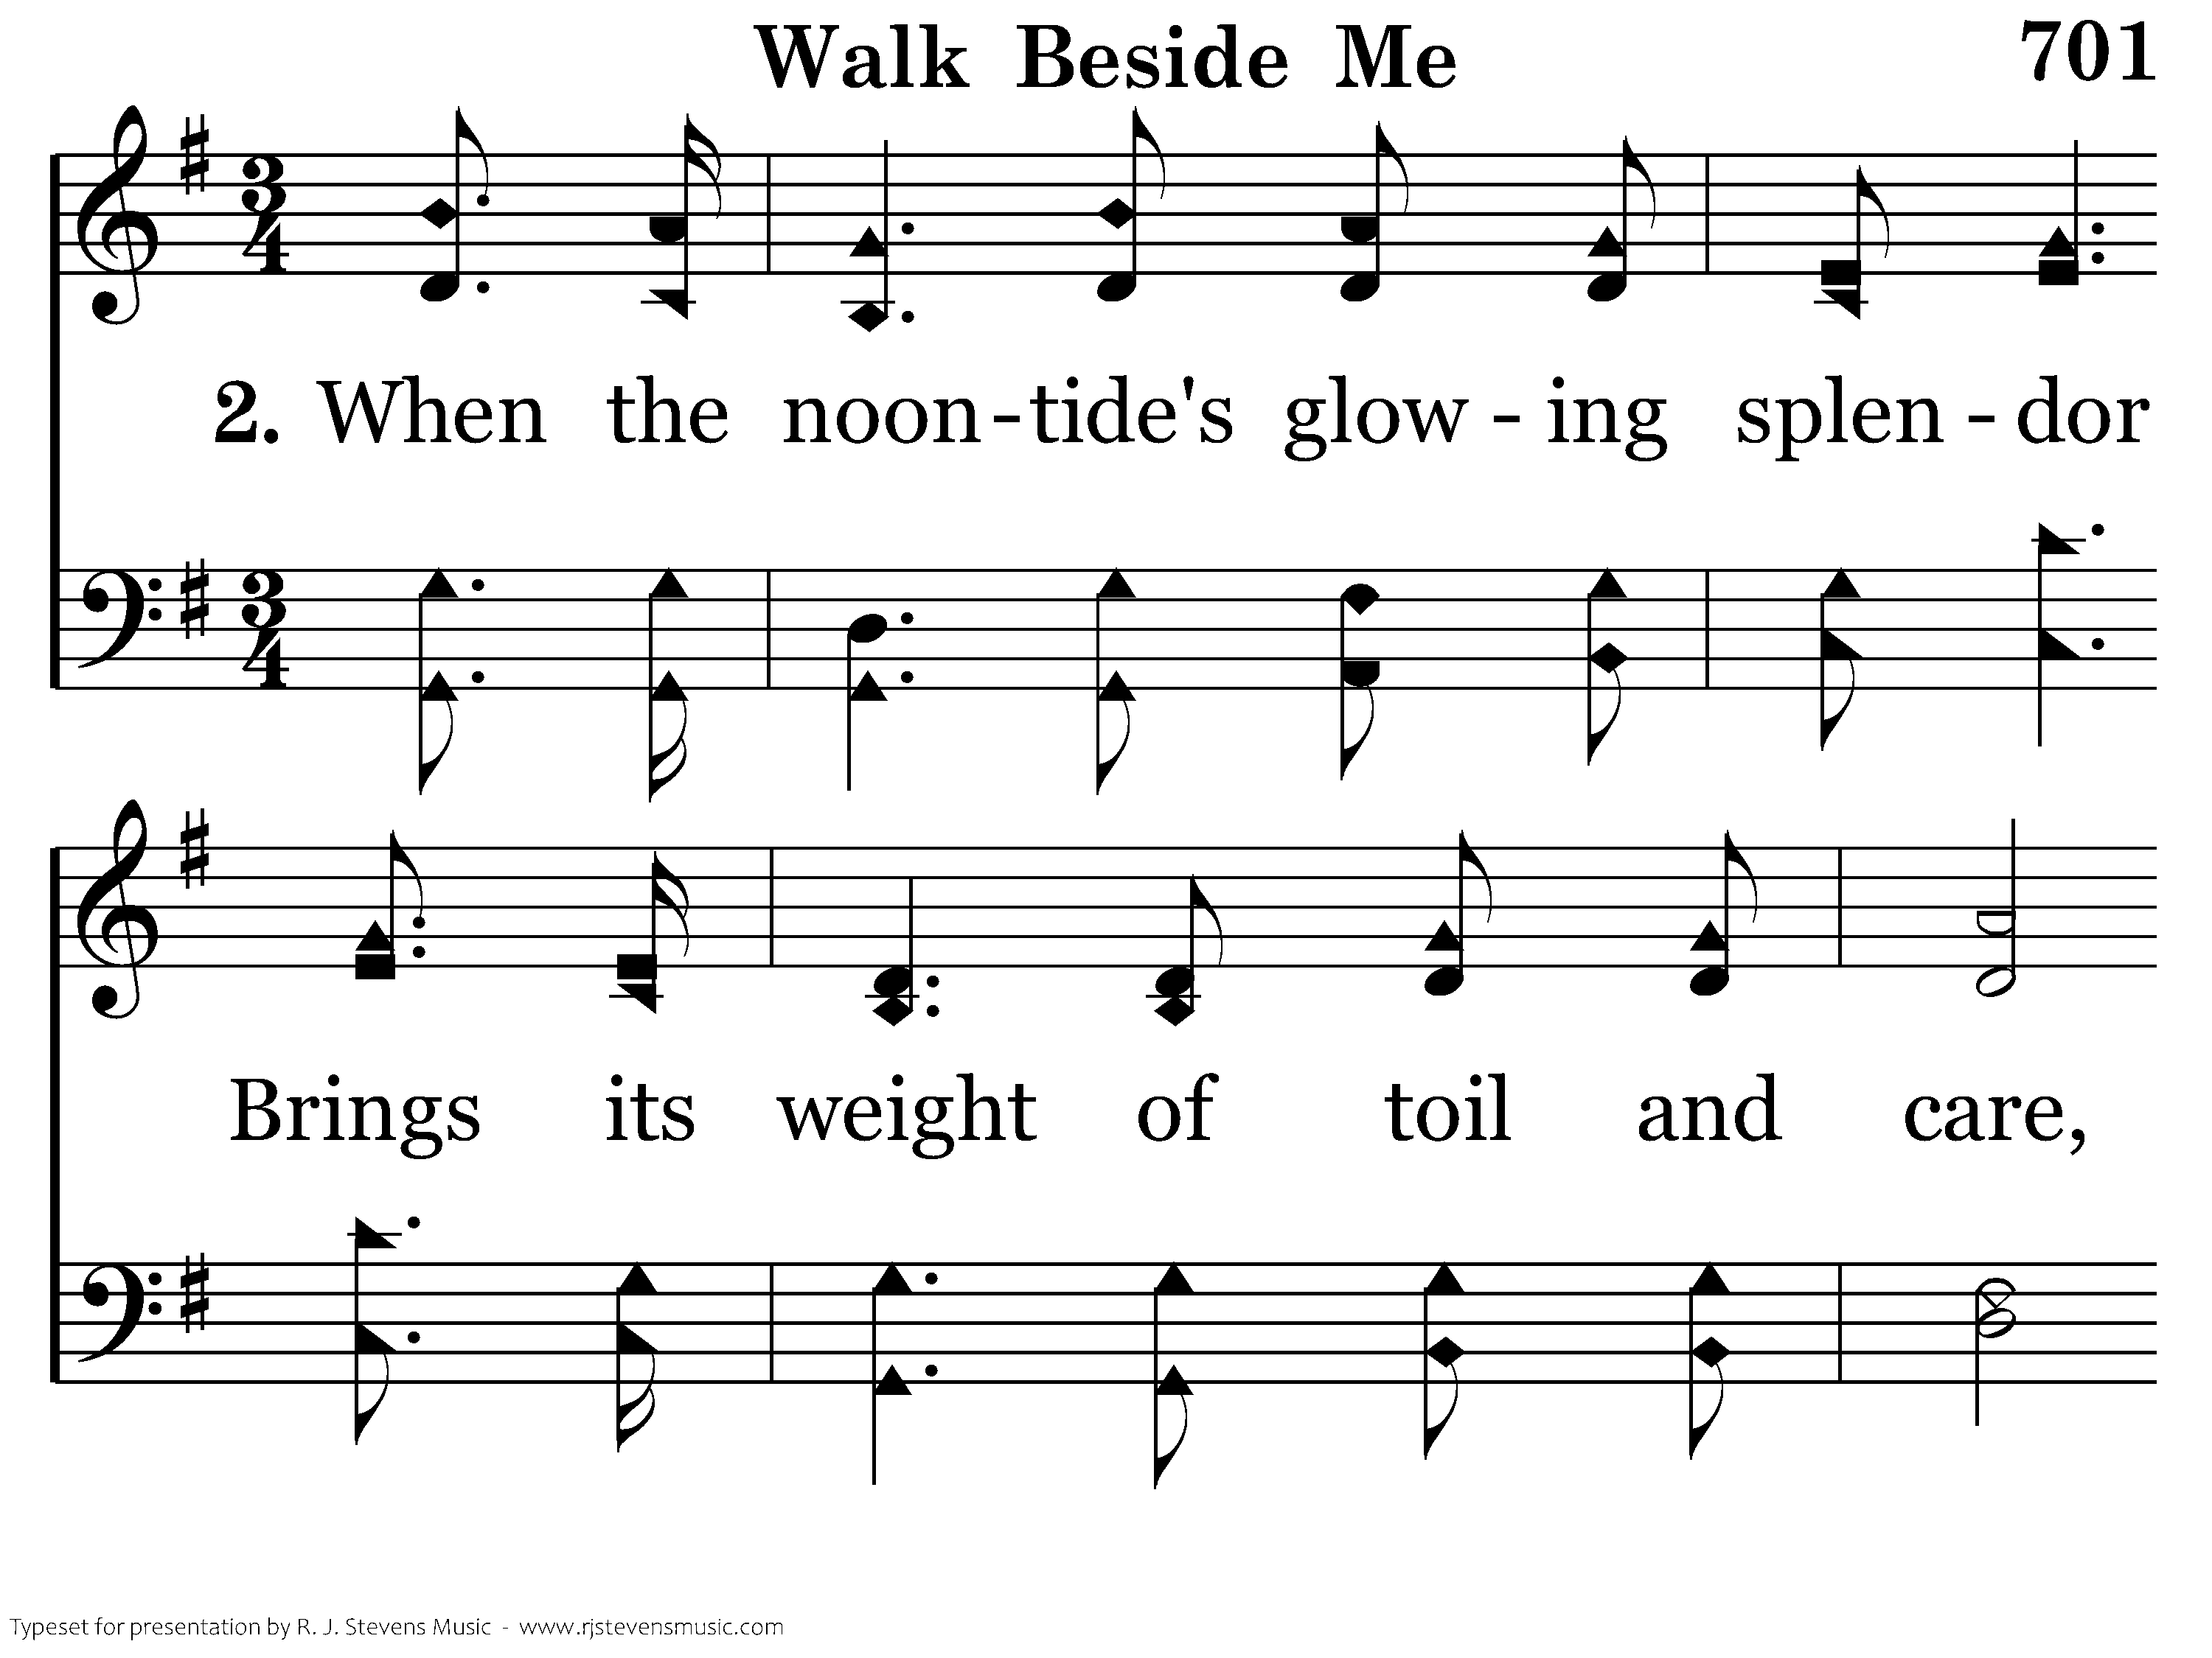
701 - Walk Beside Me - 2.1
CCLI #21593236

Slide 72
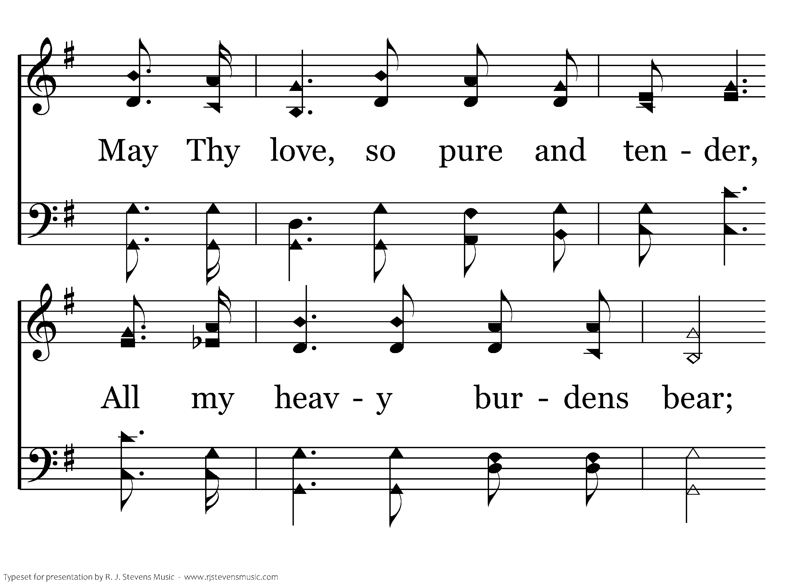
701 - Walk Beside Me - 2.2
CCLI #21593236

Slide 73
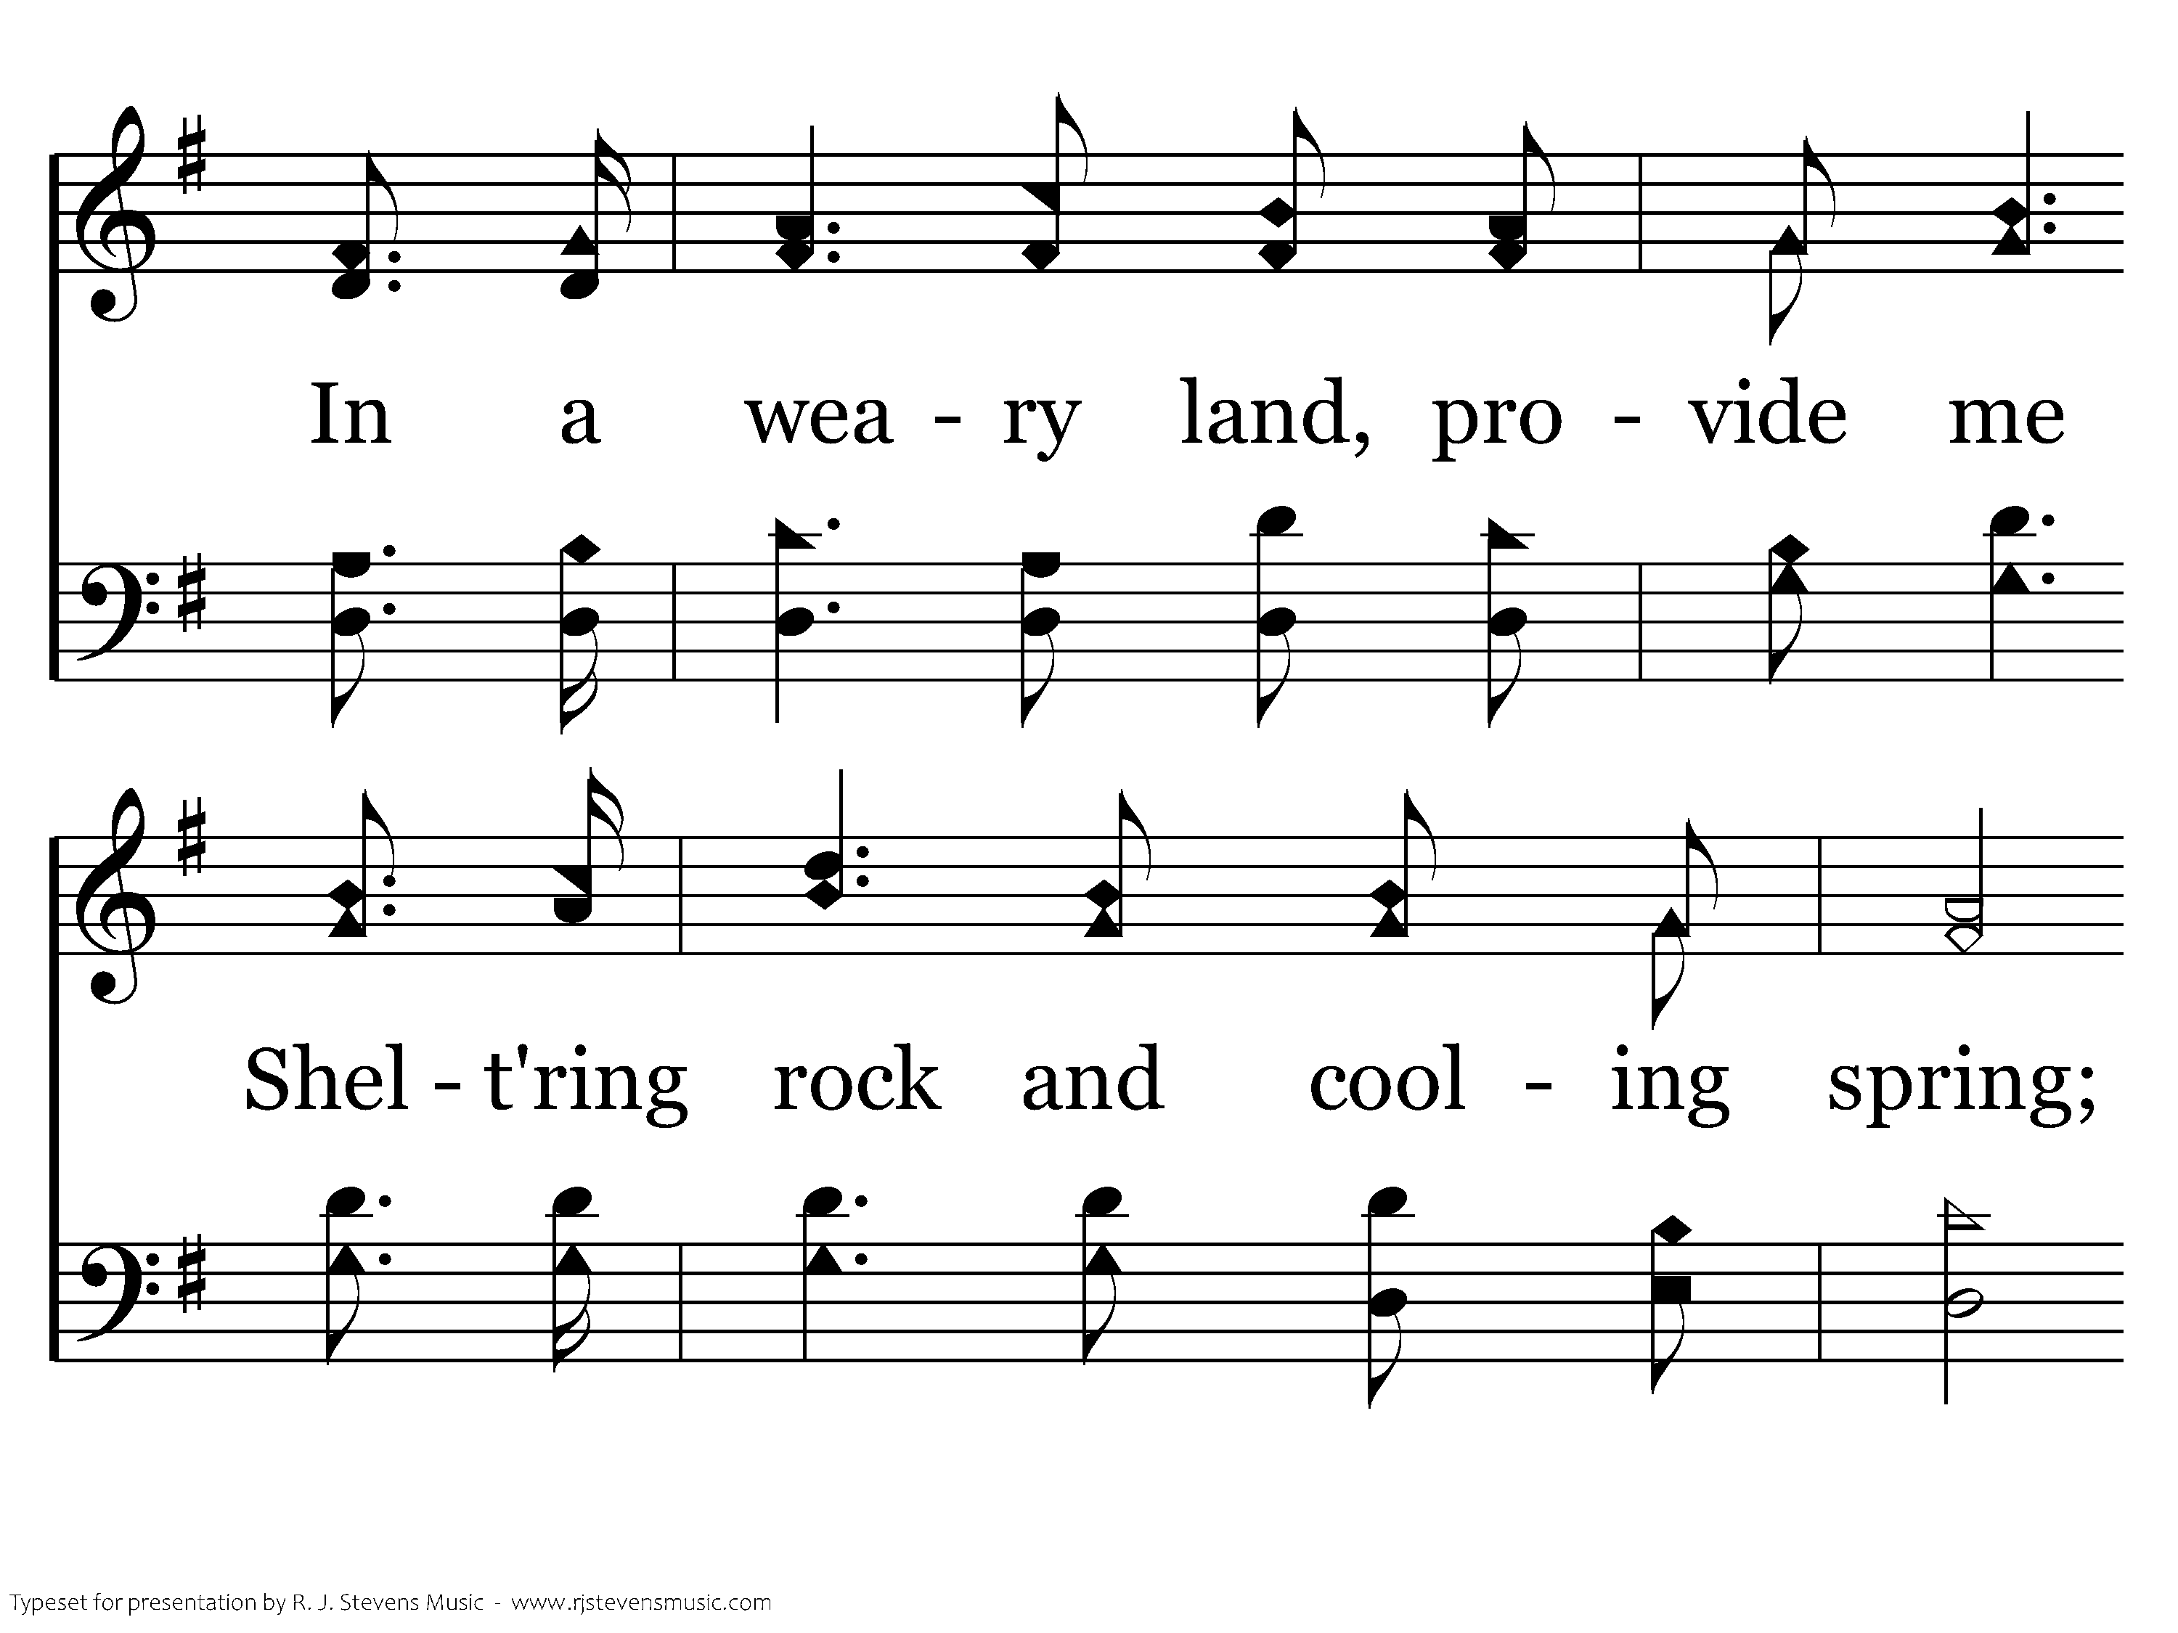
701 - Walk Beside Me - 2.3
CCLI #21593236

Slide 74
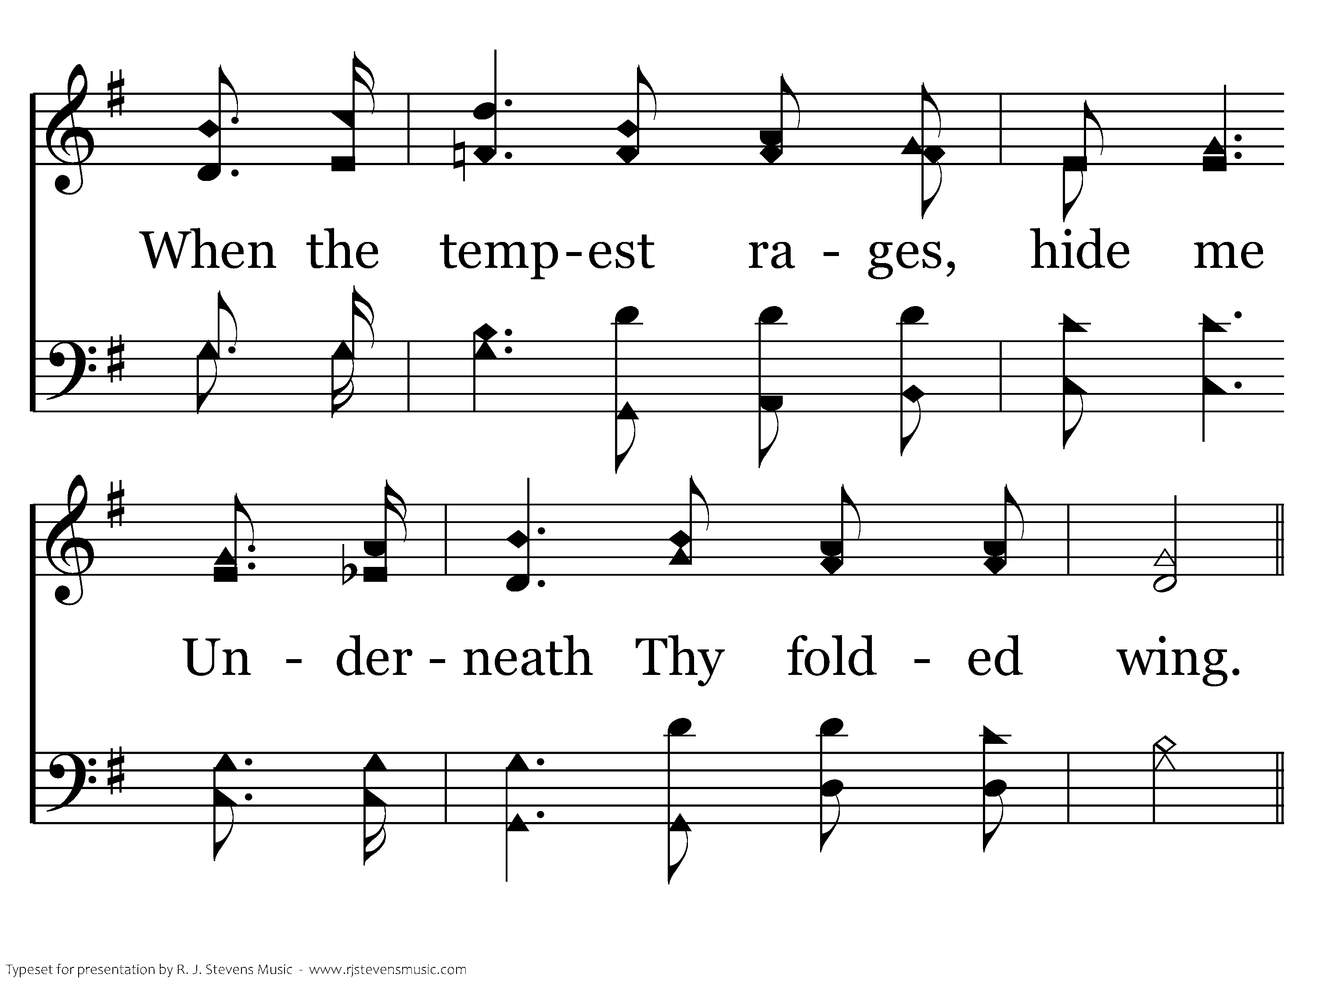
701 - Walk Beside Me - 2.4
CCLI #21593236

Slide 75
701 - Walk Beside Me - C.1
CCLI #21593236

Slide 76
701 - Walk Beside Me - C.2
CCLI #21593236
End of Verse 2

Slide 77
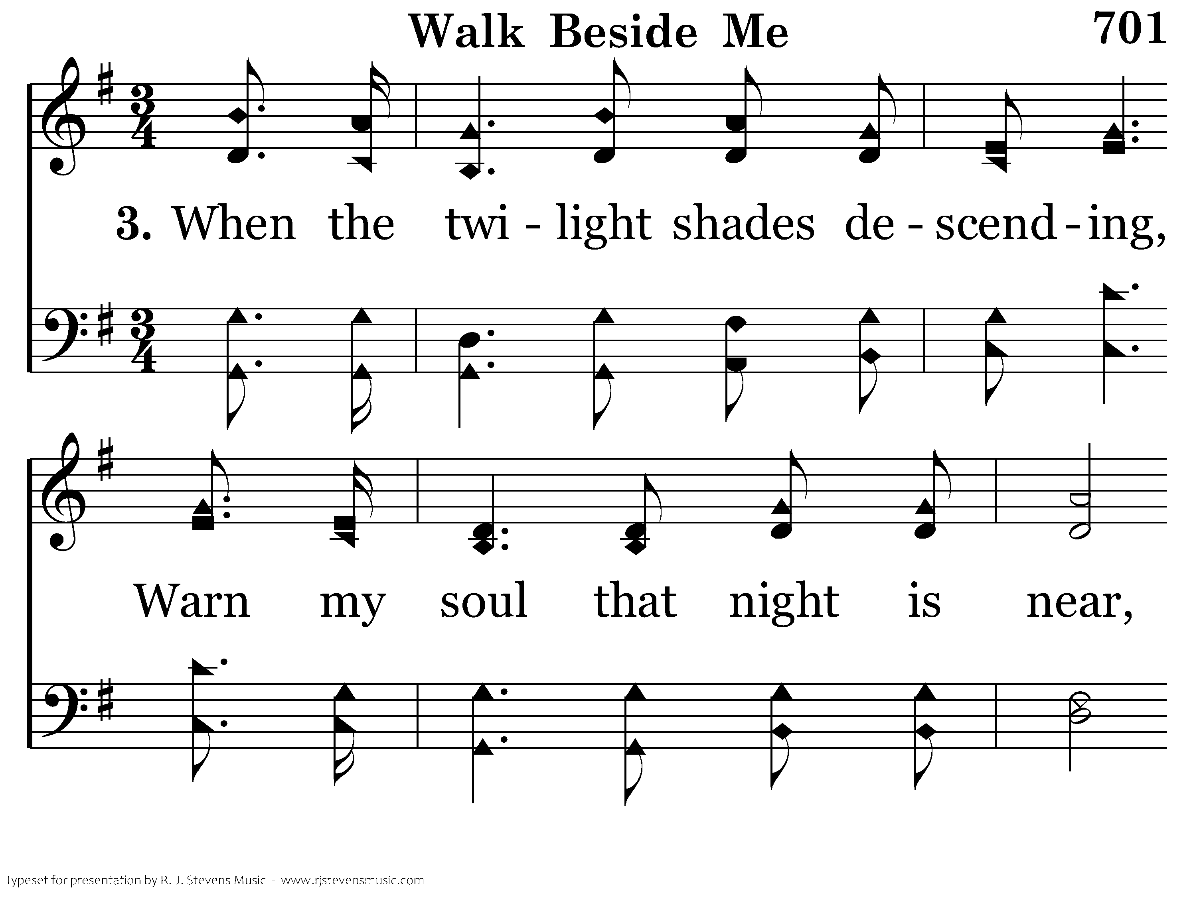
701 - Walk Beside Me - 3.1
CCLI #21593236

Slide 78
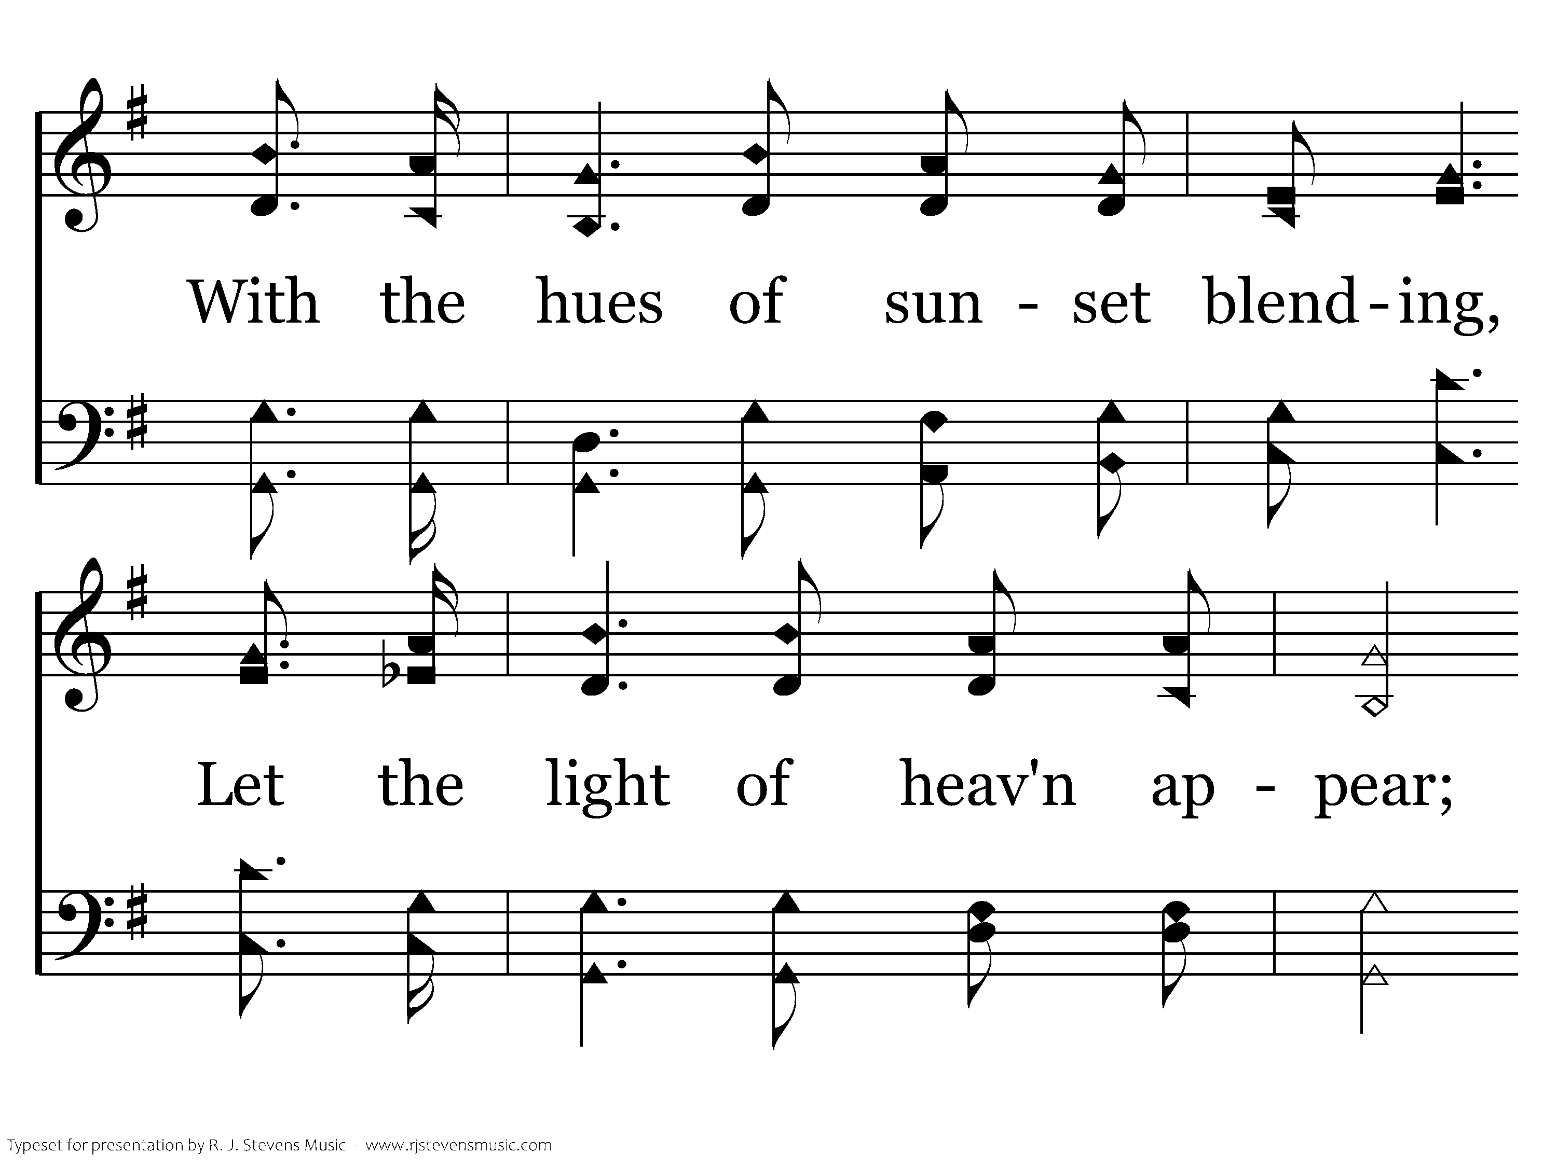
701 - Walk Beside Me - 3.2
CCLI #21593236

Slide 79
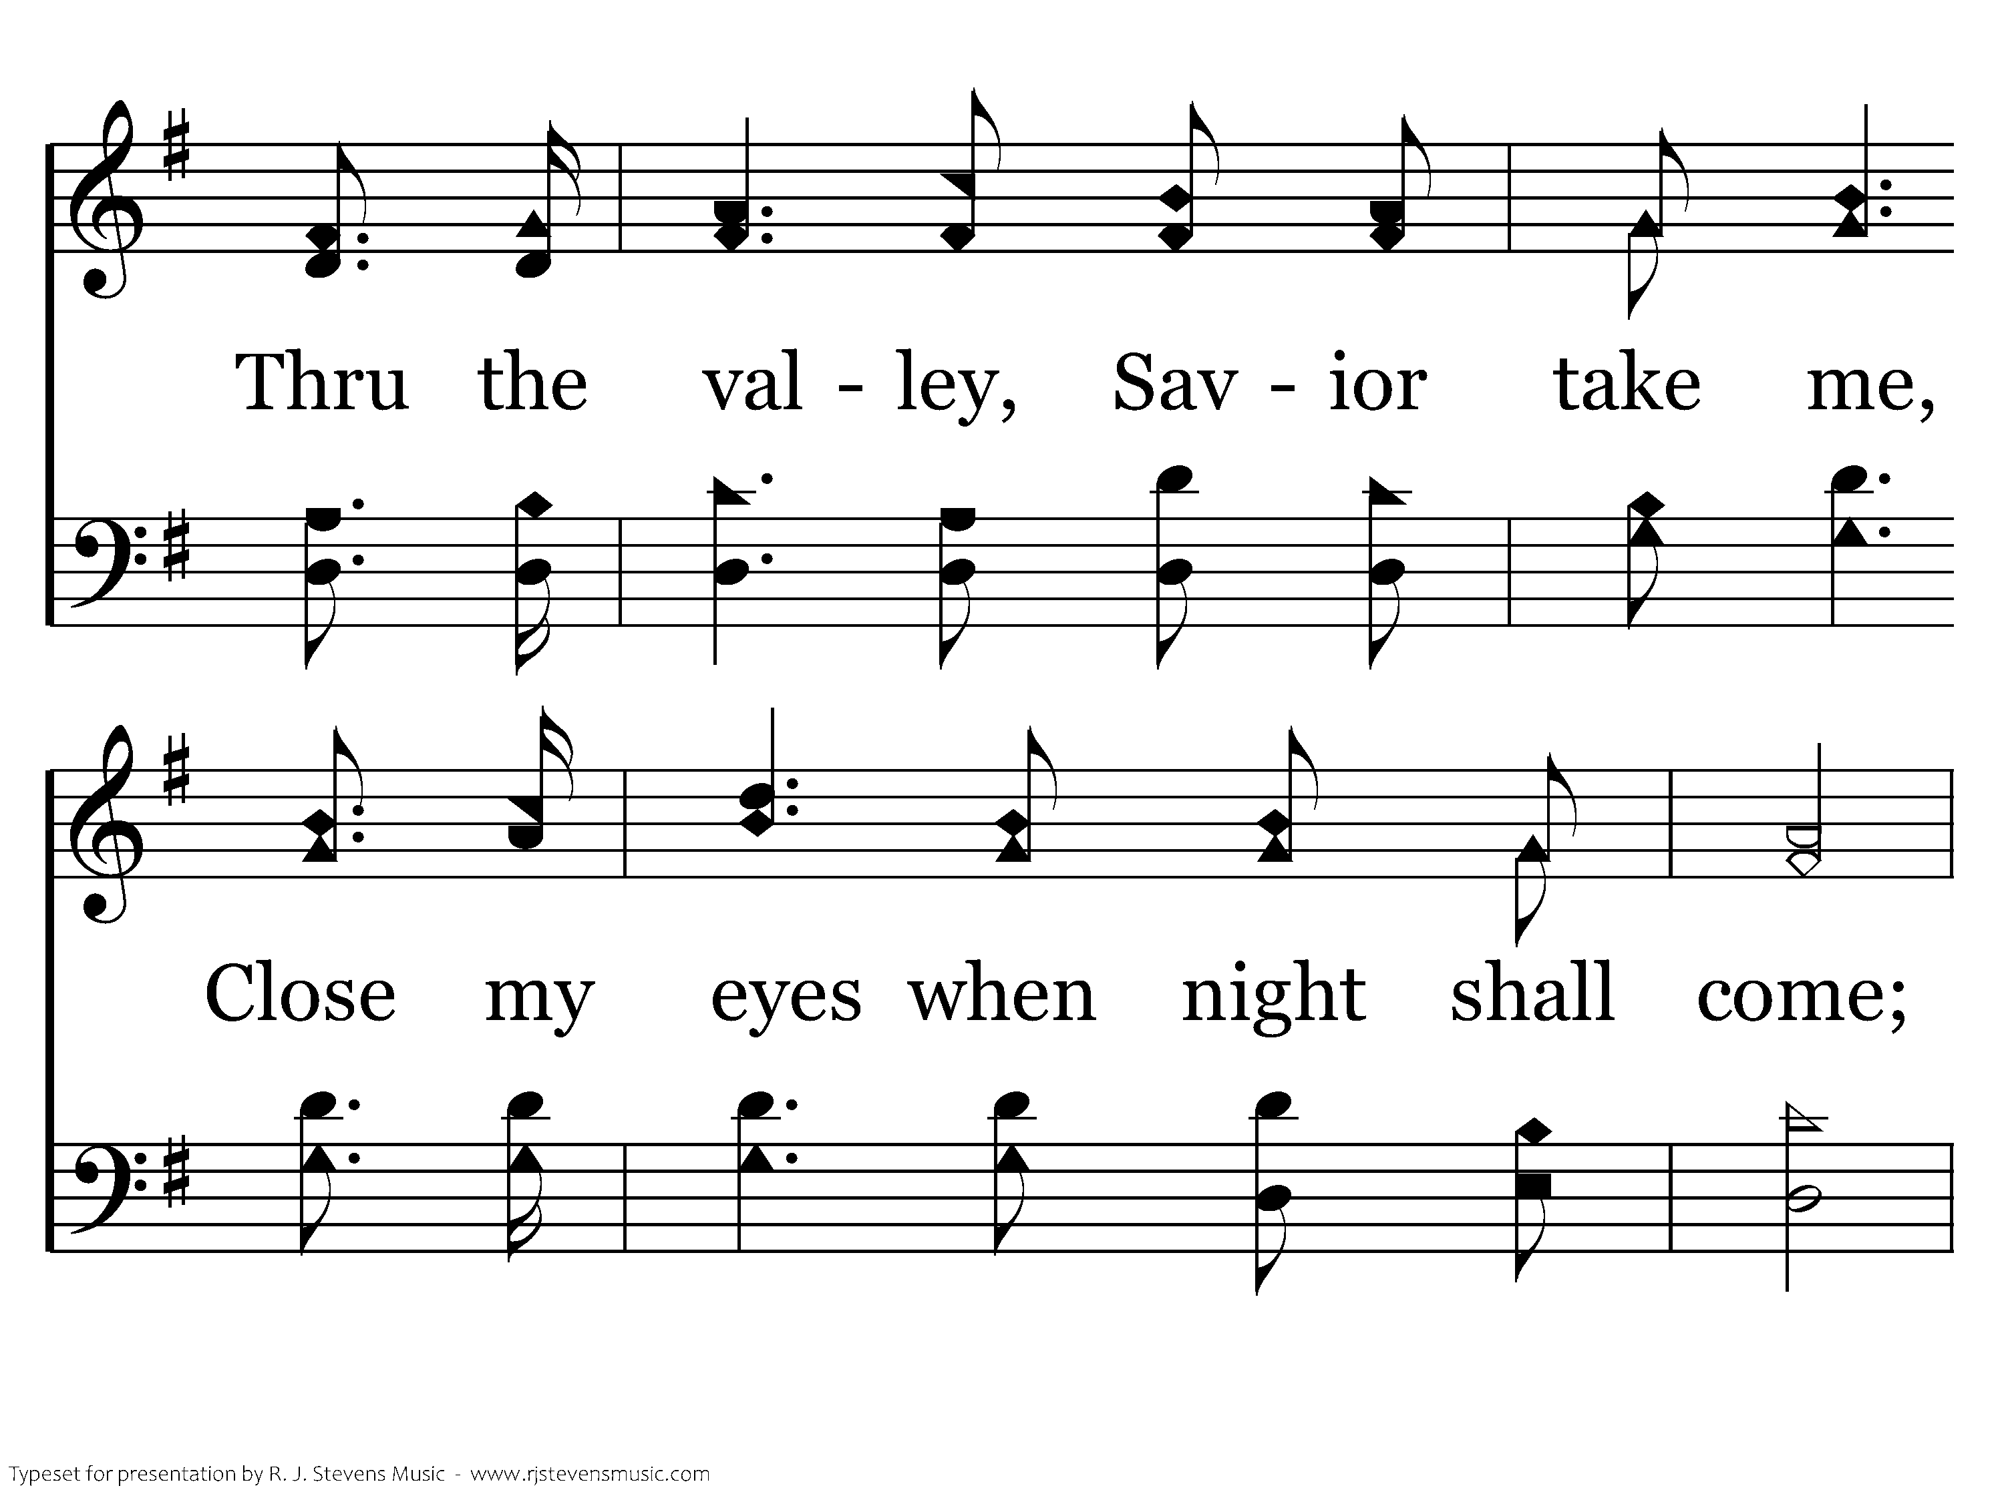
701 - Walk Beside Me - 3.3
CCLI #21593236

Slide 80
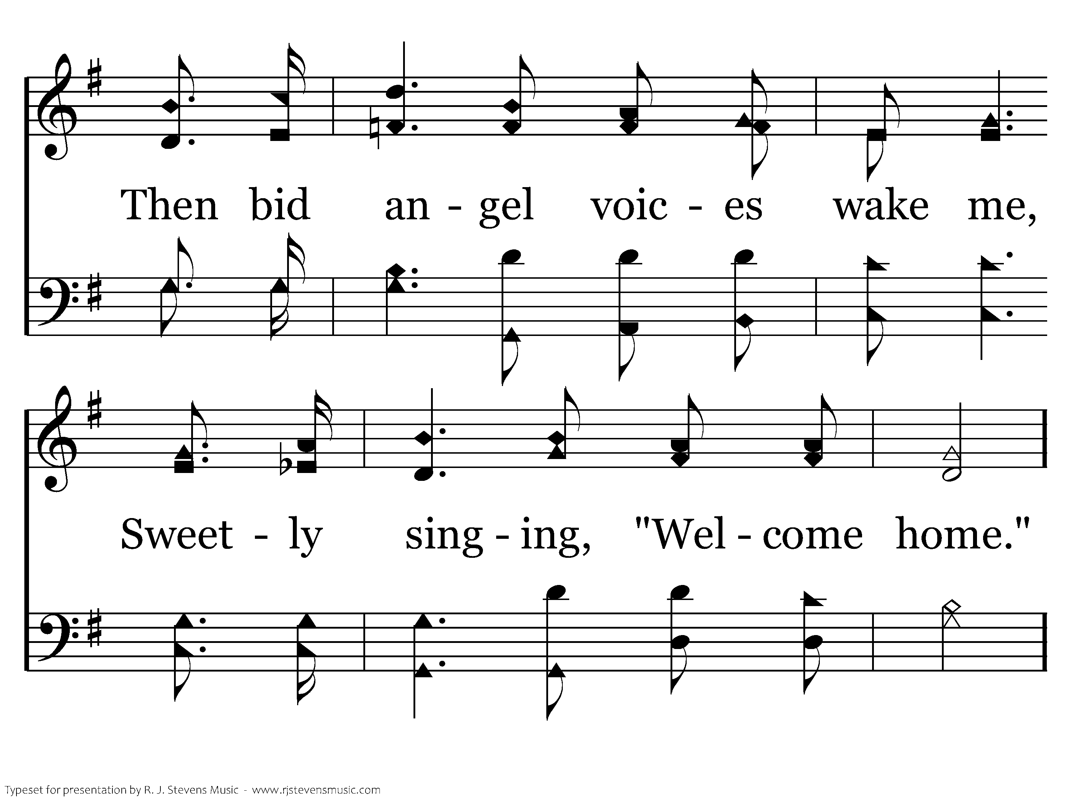
701 - Walk Beside Me - 3.4
CCLI #21593236

Slide 81
701 - Walk Beside Me - C.1
CCLI #21593236

Slide 82
701 - Walk Beside Me - C.2
CCLI #21593236

Slide 83
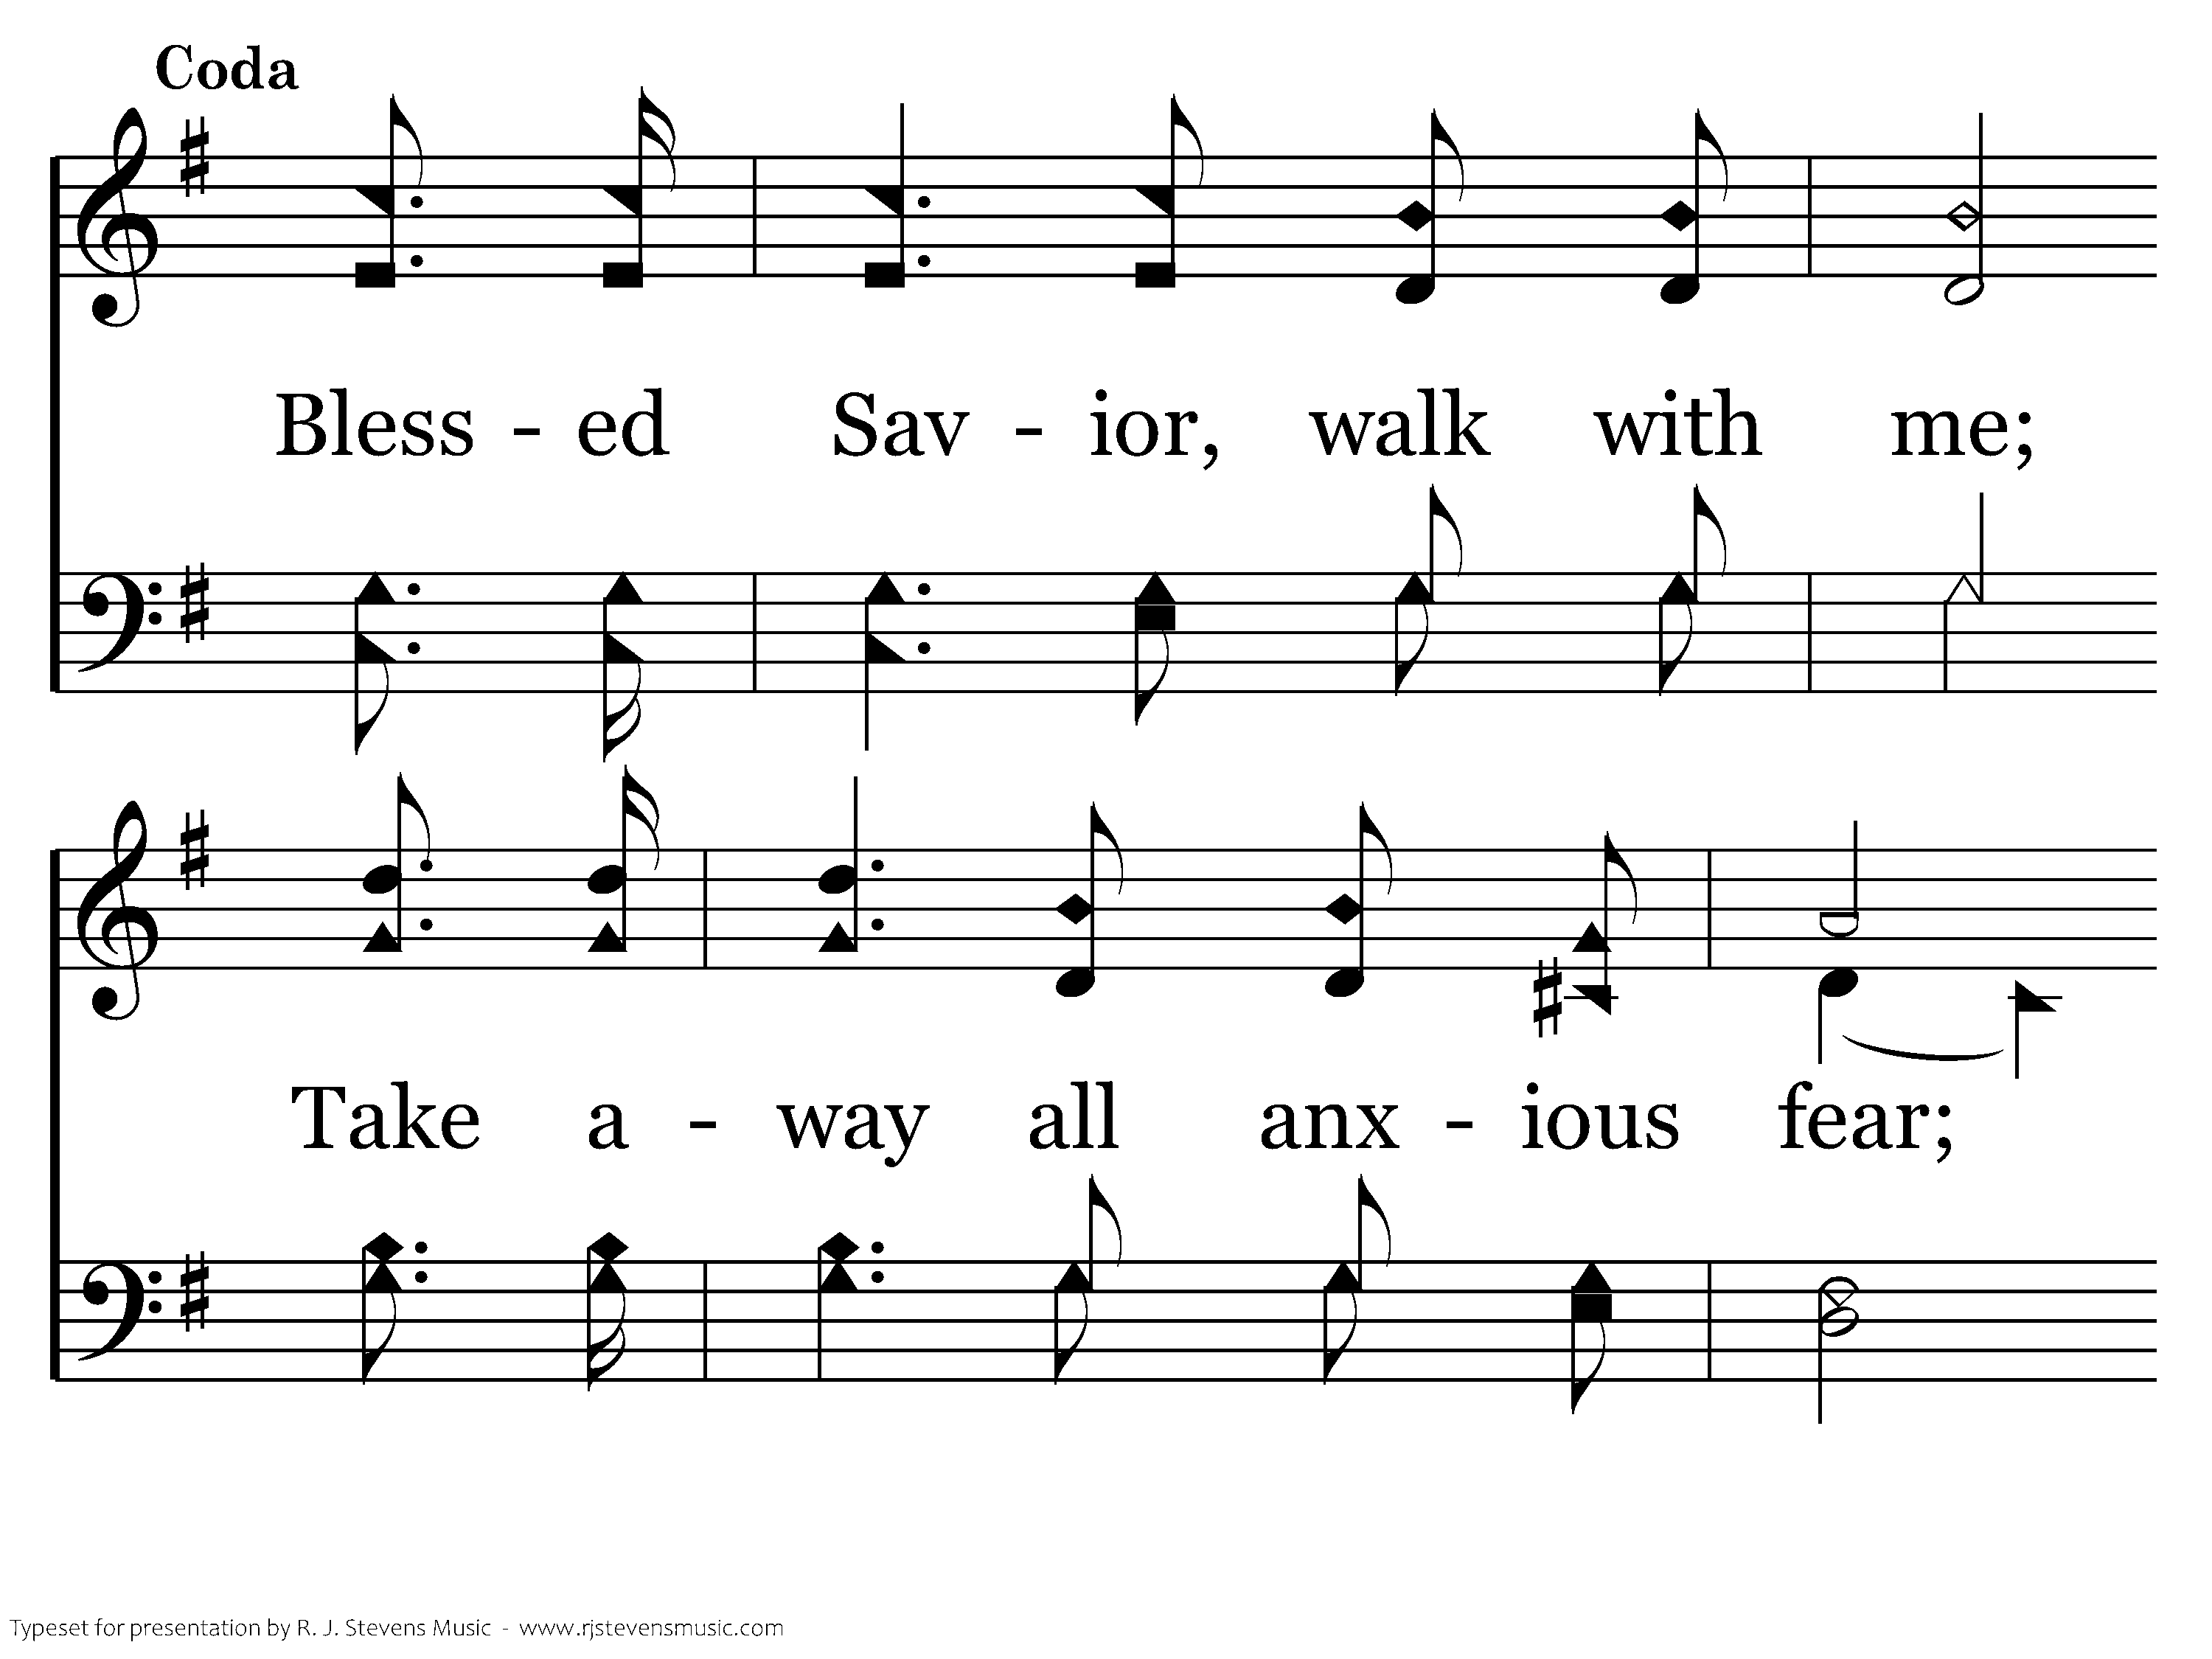
701 - Walk Beside Me - D.1
CCLI #21593236

Slide 84
701 - Walk Beside Me - D.2
CCLI #21593236
End of Song

Slide 85
Prayer

